Slide 1
TEAMUP For Value Based Procurement
April 19, 2024

Slide 2
Objectives:
Participants attending this training will:
Understand how value-based procurement in school food service can improve the quality of food and strengthen community food systems.
Identify steps to take to increase value-based procurement practices.
Identify food categories for beginning value-based procurement language in solicitations.
Practice developing value-based procurement solicitations specific to individual districts.
Discuss the idea of developing solicitations awarding vendors based on the quality of food available rather than the lowest price point.
Practice developing solicitation award criteria scoring percentages for quality over price.

Slide 3
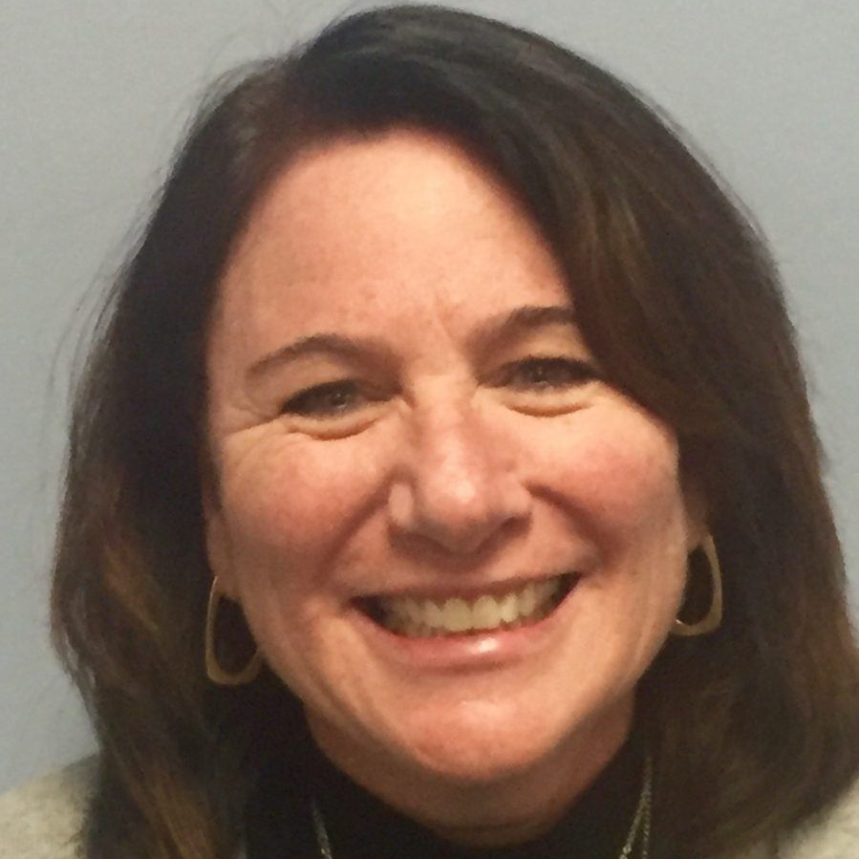
Introductions and Overview
Kathleen Britton, SNS, Director of Child Nutrition Programs at the Utah State Board of Education
Dr. Katie Wilson, Executive Director of the Urban School Food Alliance

Slide 4
TeamUp Expert Panelists
Miguel Villarreal, MBA, Interim Co-Executive Director, National Farm to School Network
Bertrand Weber, Director, Culinary and Wellness Services, Minneapolis Public Schools
Jo Dawson, MS, SNS, Child Nutrition Consultant, Formerly with Child Nutrition Programs at the Alaska Department of Education and Early Development

Slide 5
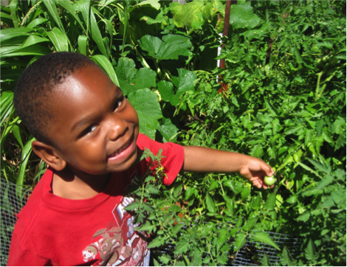
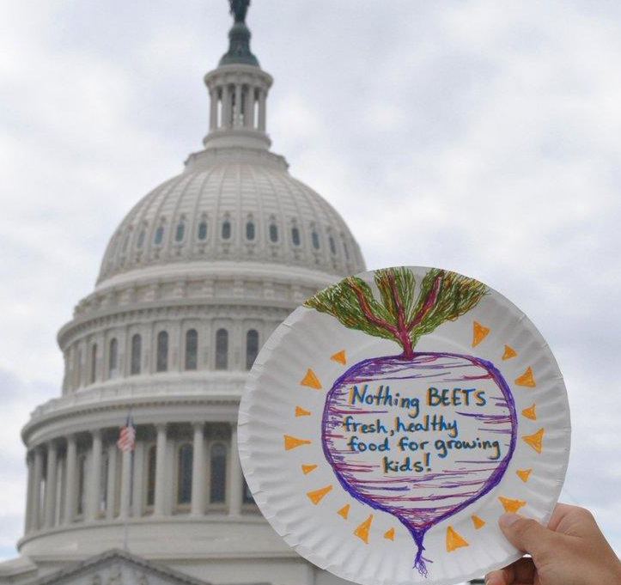
Miguel Villarreal, Interim Co-ED TeamUP 2024 Values Based Procurement Se

Slide 6
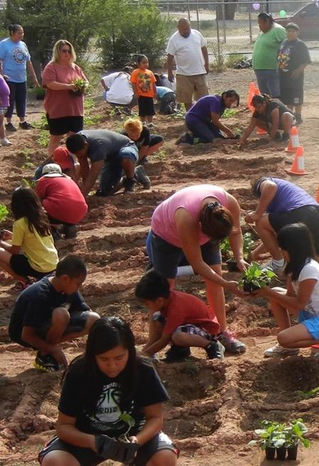
Why Farm to School?
Kids Win!
Farmers Win!
Communities Win!
Notes:
Triple win of F2S
Examples:
- Kids who participate in F2S eat more servings of fruits and vegetables.
By shortening supply chains, farmers keep a bigger share of the dollar.
Communities win when farmers reinvest in their local communities, and kids take what they learn home with them.
F2S uniquely sits at the intersection of numerous sectors and these cross-sectoral benefits include to public health, education, economic development, and the environment

Slide 7
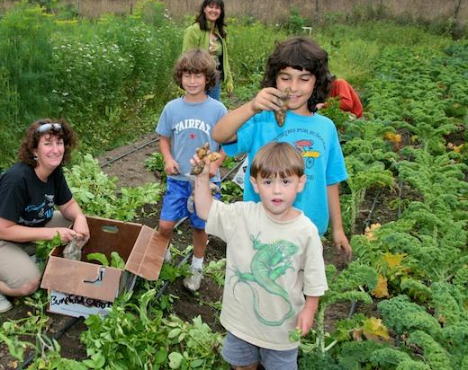
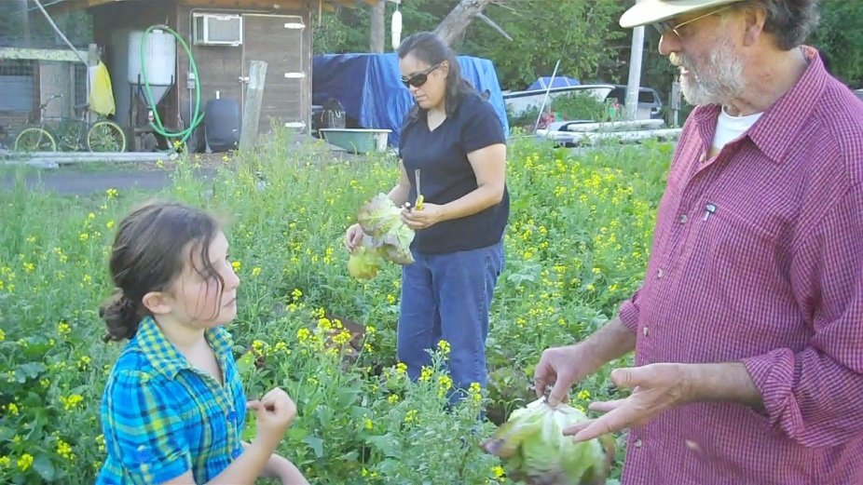
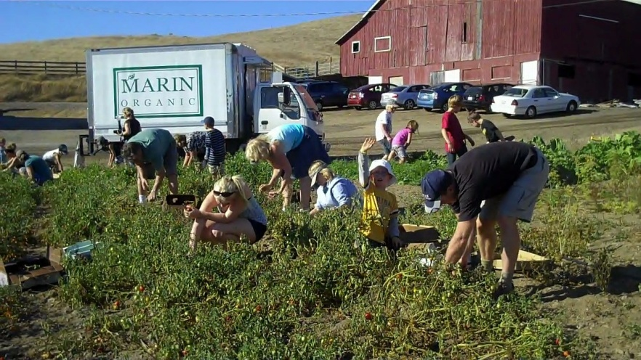
NFSN Values
Health
Impact
Environmental
Justice
Economic
Justice
Animal
Welfare
Respecting FS Staff
and Educators
Racial Equity
Health
Impact
‹#›
Notes:
Our Values V.3 w/ Animations

Slide 8
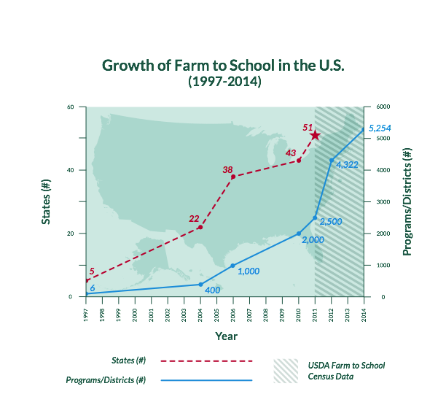
We are a part of a Growing Movement!
‹#›
Notes:
1996-97 - F2S programs started in CA, FL
2004 – farmtoschool.org website was launched – 1st attempt to consolidate information into one clearing house – 20 states
2007 – Launch of the National Farm to School Network
2013-2014 – F2S is in all 50 states
The farm to school movement has grown from a handful of schools in the late 1990s to initiatives in all 50 states, DC, and US Territories today

Slide 9
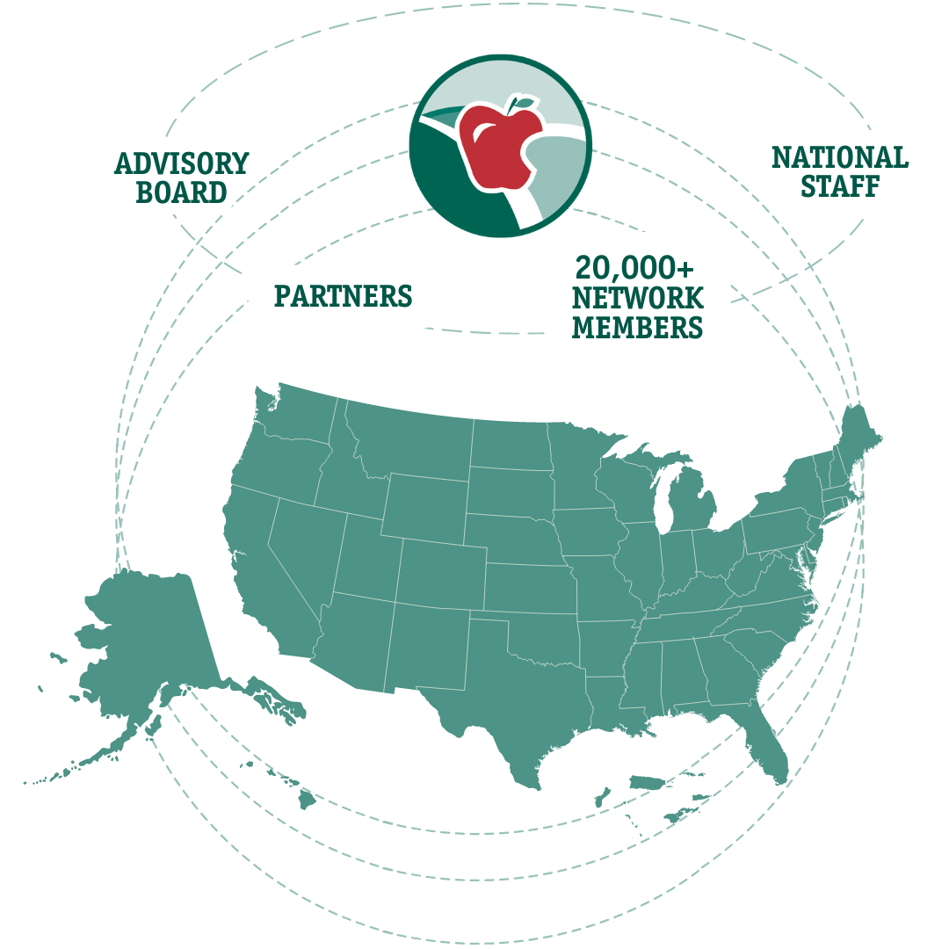
Our Network
‹#›
Notes:
Who we are:
More than 20,000 members
Advisory Board
National staff

Slide 10
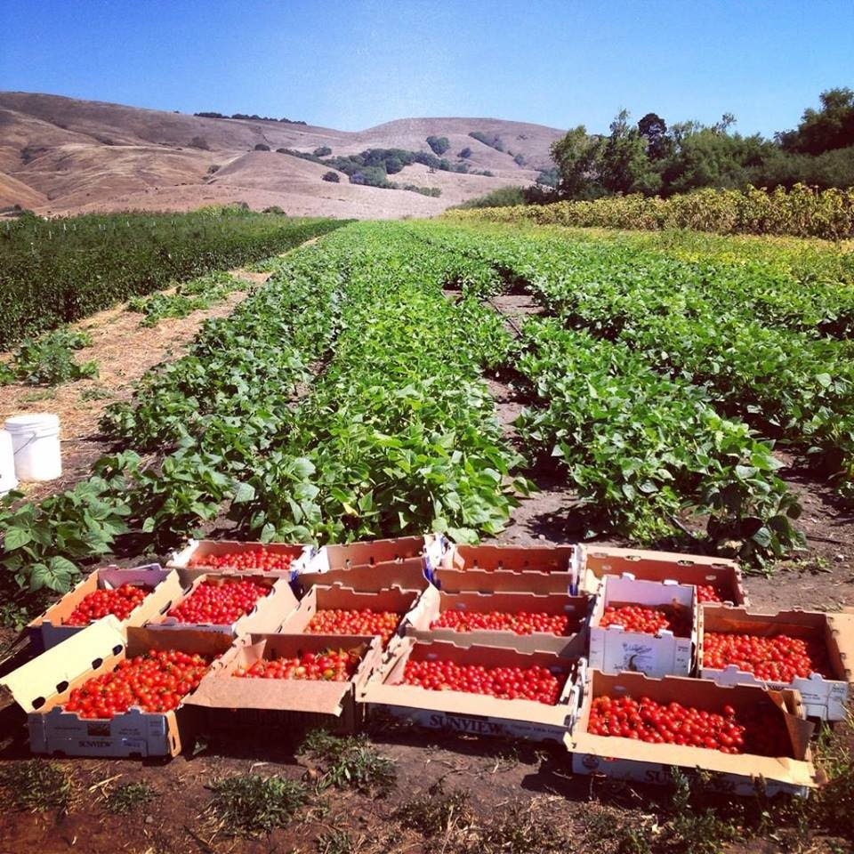
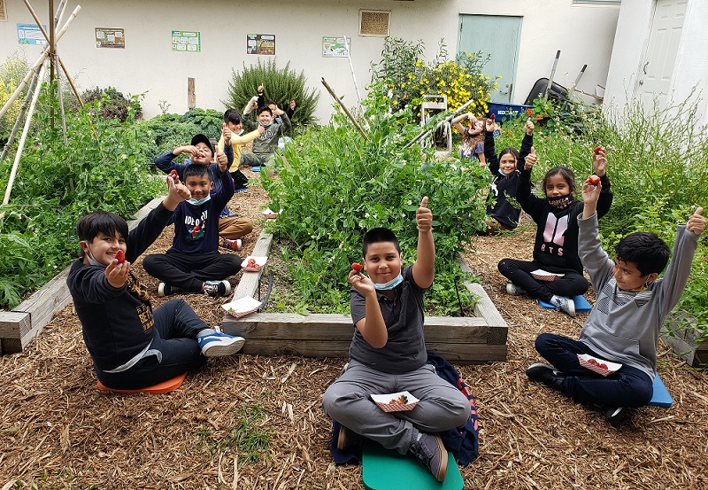
Core Elements of Farm to School
Education
School Gardens
Values Based Procurement
‹#›
Notes:
How we define F2S, the “what”
When we say “farm to school,” we’re talking about activities that support the connection communities have with fresh, healthy food and local food producers and ways to engage children in learned about food and agriculture
There is no one defined “program,” but collectively farm to school activities empower children and their families to make informed food choices while strengthening the local economy and contributing to vibrant communities.
Although there is no one defined program, these elements combine to make success in F2S.

Slide 11
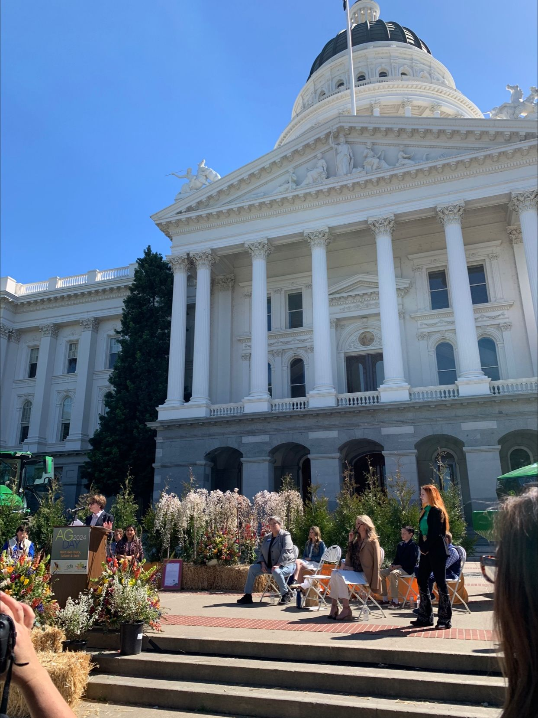
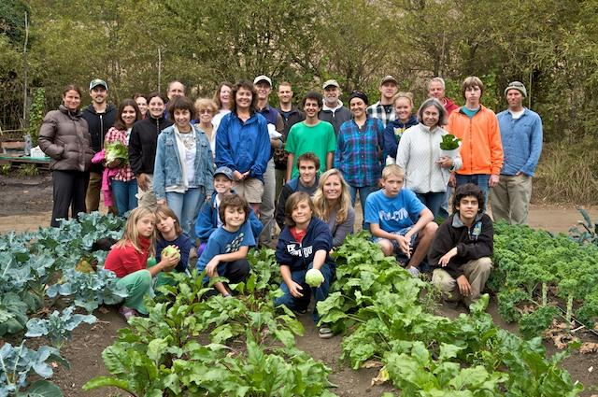
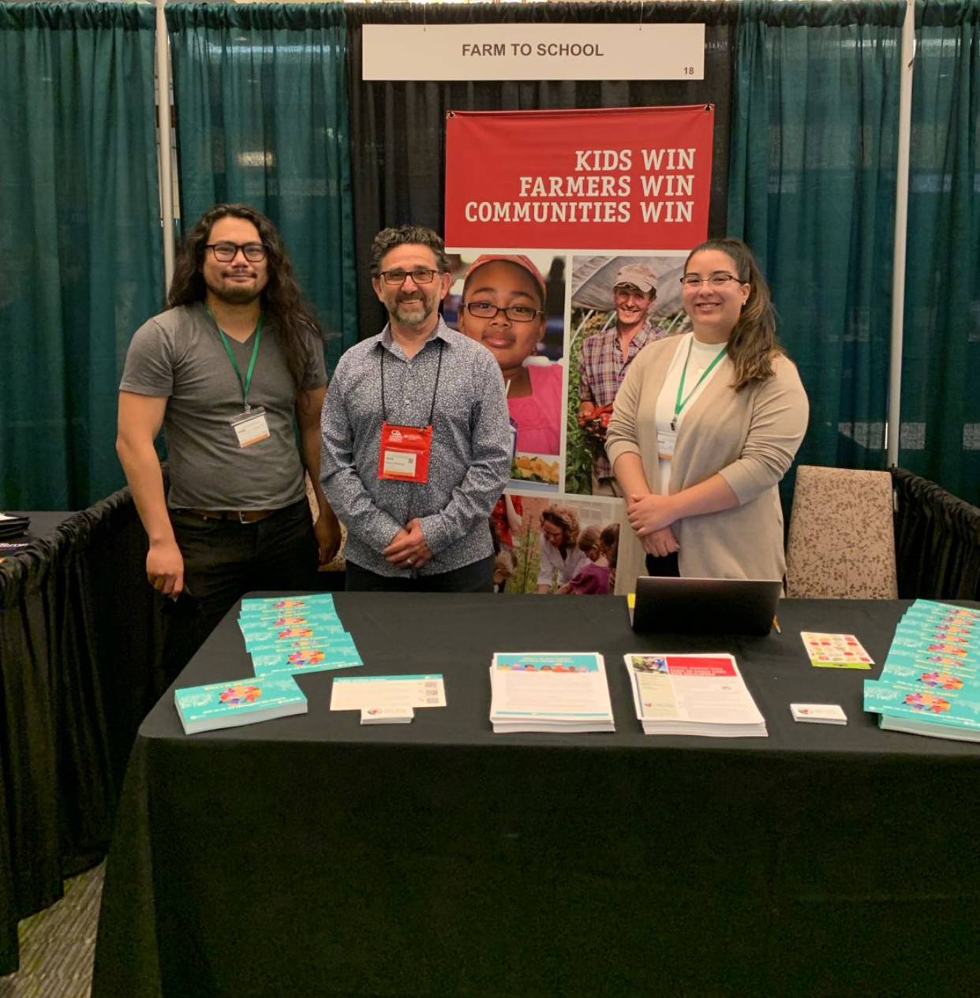
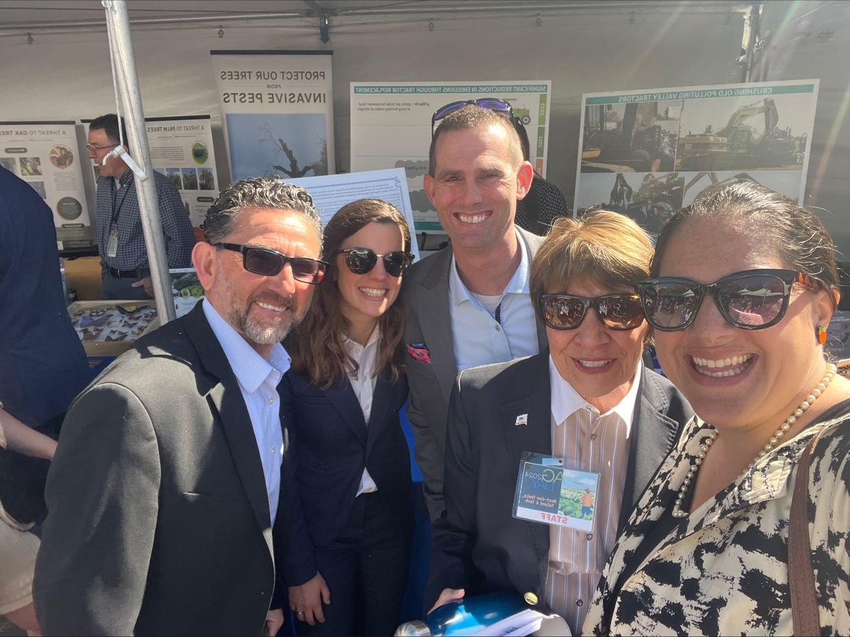
NFSN Core Functions
We are a hub for:
Information
Networking
Advocacy
Connecting people to:
Resources
People
Policy

Slide 12
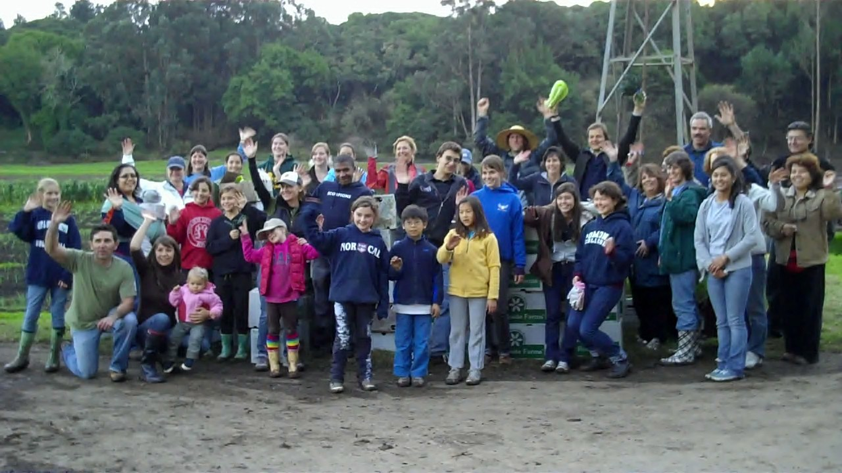
Our Call to Action
100% of Communities Will Hold Power in a Racially Just Food System

Slide 13
Become A Member Today
Benefits of becoming a member:
Receive our monthly e-mail newsletters with the latest farm to school stories and policy news
Receive our This Week in Farm to School newsletter for a weekly roundup of events, webinars, jobs and funding opportunities
Stay up-to-date on the latest stories, best practices, learning opportunities and policy actions to help farm to school grow nationwide.
farmtoschool.org/join
Notes:
Current Advocacy Work V.2
For years, NFSN has advocated for policies that make it easier for schools to purchase local food, eliminate barriers to equitable implementation, and improve students’ health.
Highlight recent NFSN language adopted in USDA proposed child nutrition rule
https://docs.google.com/document/d/1awEB5BALYX5jbffu8VGAB5zYhLFfmjsEZbCcH7AJEro/edit?usp=sharing
https://www.instagram.com/p/CpN_QHasgD_/

Slide 14
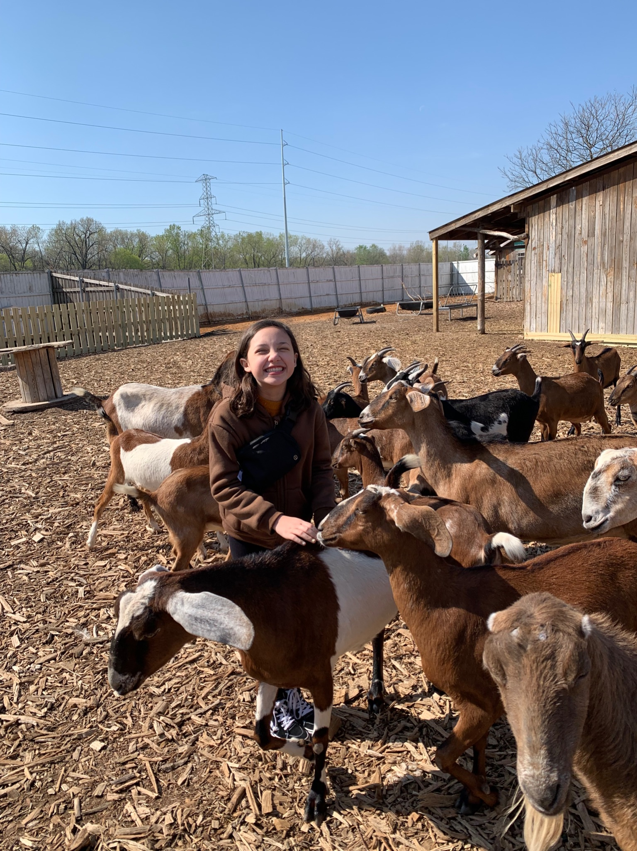
Thank You!
Questions?
Miguel Villarreal, Interim Co-Executive Director
miguel@farmtoschool.org
707 338 7644
Farmtoschool.org
‹#›

Slide 15
Value Base Procurement
&
Building Relationship with Farmers

Slide 16
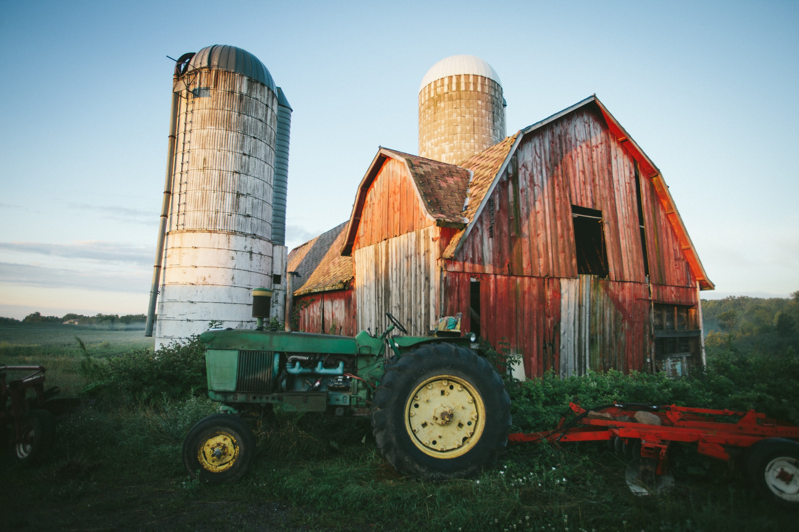
Local Harvest
Regional Sourcing
Small to mid-size new, returning and emergent farmers
Larger established farmers in the 5-state upper Midwest area
Produce, Grains and Legumes
Produce, Proteins, Breads, Dairy , and small other manufacturers
Awards from yearly RFP prior to spring planting
Contract based on yearly RFP in early spring.
Notes:
BW

Slide 17
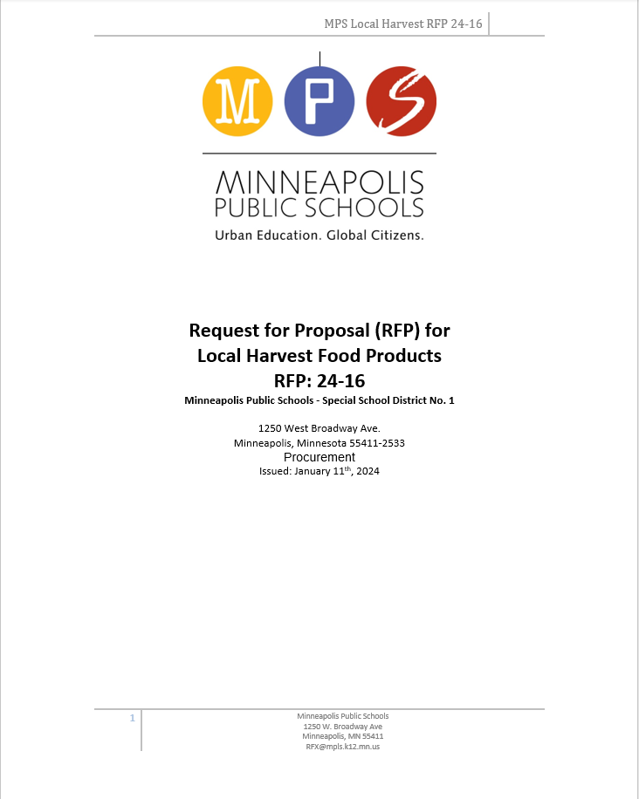
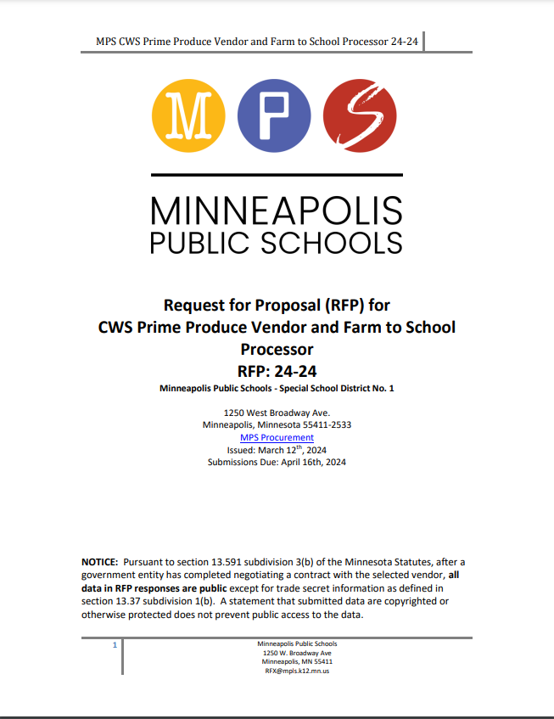
Local Harvest RFP
Request for Proposal
Annual competitive bid process
Open to all interested farms, farm cooperatives, food hubs, and aggregators

Slide 18
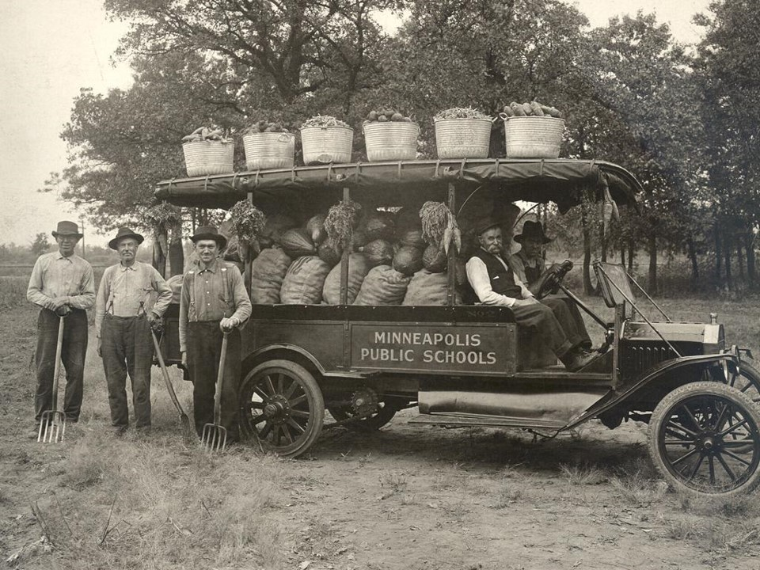
150 Bid Items Received
From 21 separate organizations
56 items Awarded
16 Farms and Cooperative
176,000 pounds | $225,000
Free-range turkey & grass-fed beef
$120,000
Notes:
BW

Slide 19
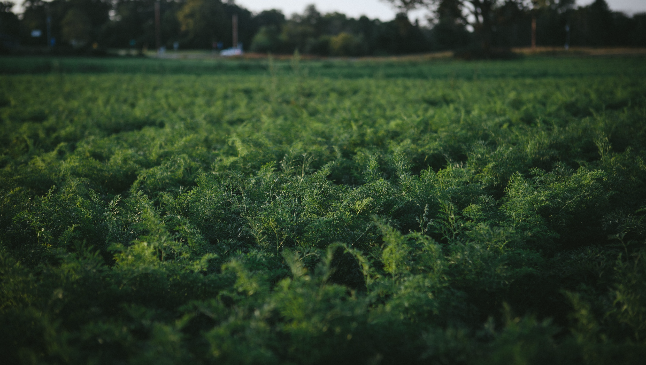
Farm
Aggregator
(in some cases)
Produce Company
Culinary Center or School
Notes:
BW
https://www.youtube.com/watch?v=NfKVUEvPUbo&t=1s

Slide 20
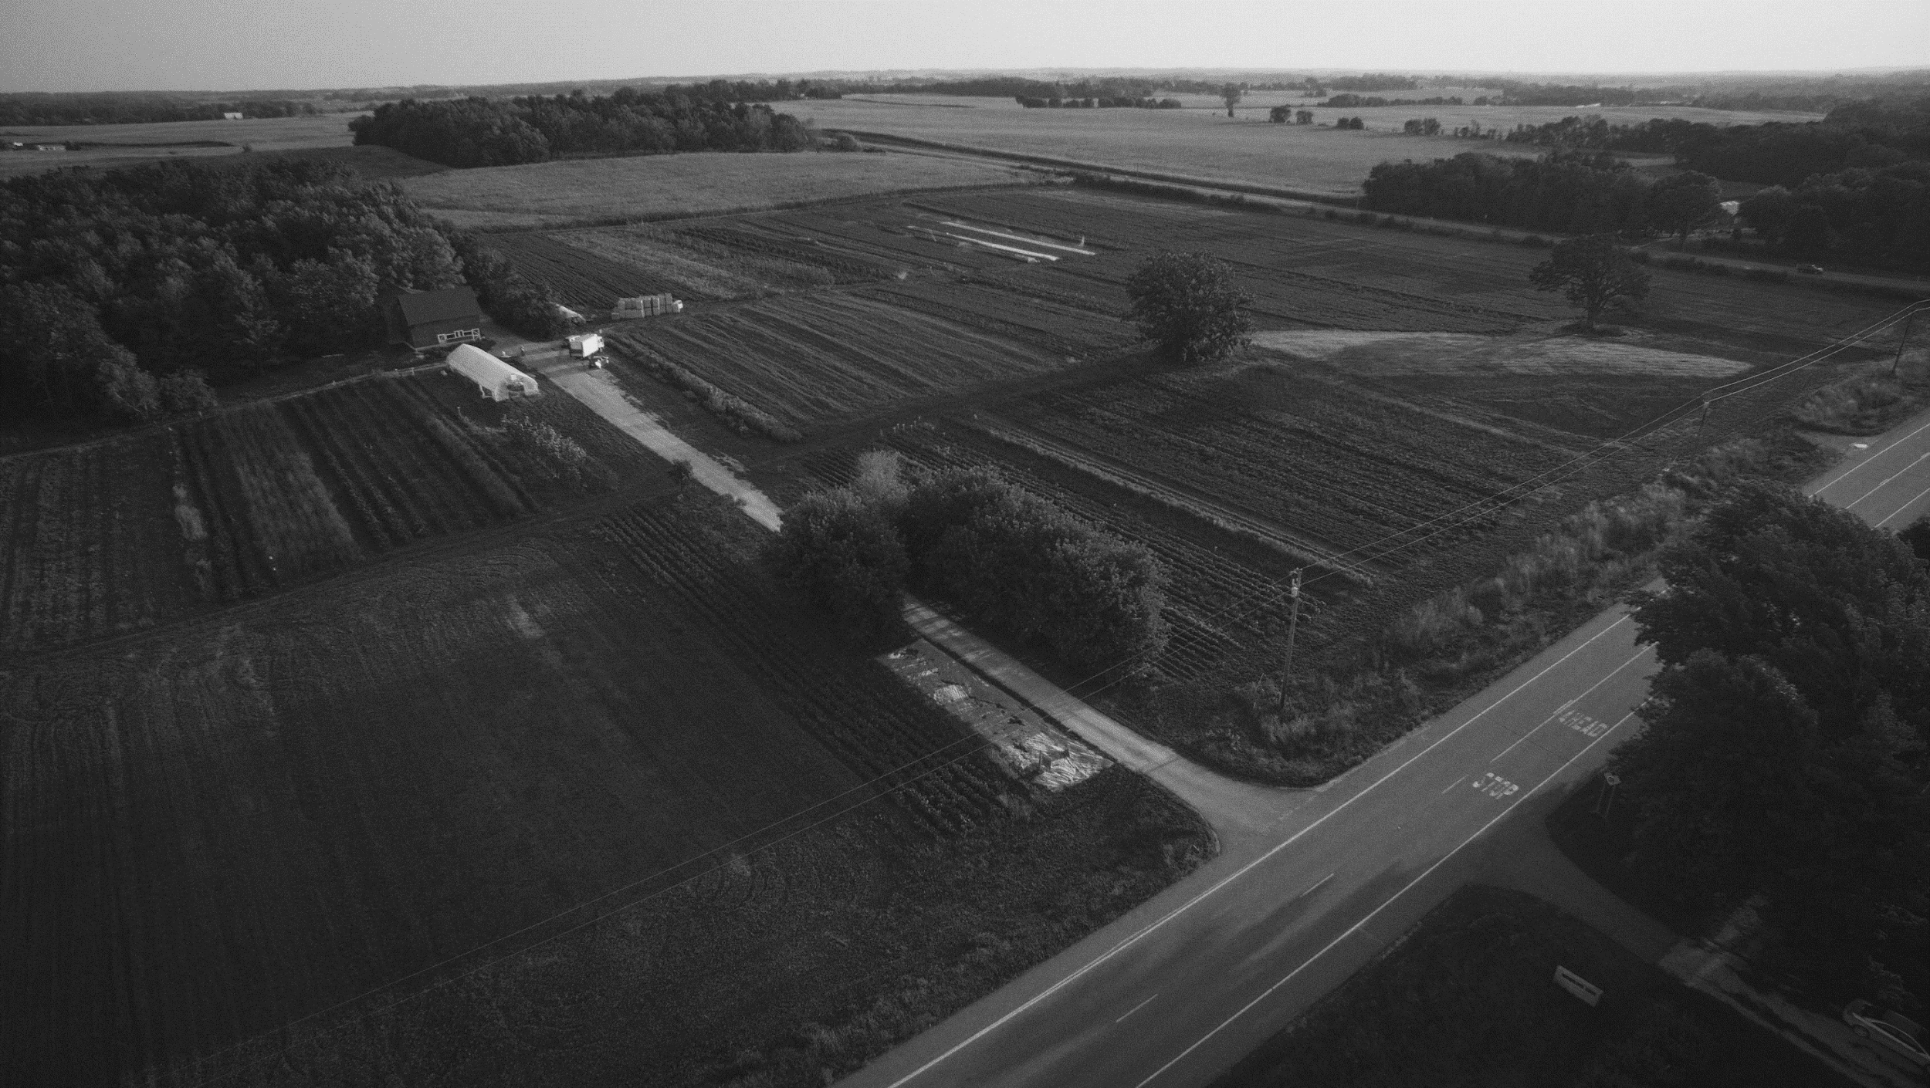
MPS Forward Contracting Timeline
Mid December:
Information Meeting for Prospective Growers
Mid-February:
Farm Proposals Due
Mid January:
Issue Local Harvest RFP
Late February:
Award produce items to farms
Notes:
BW

Slide 21
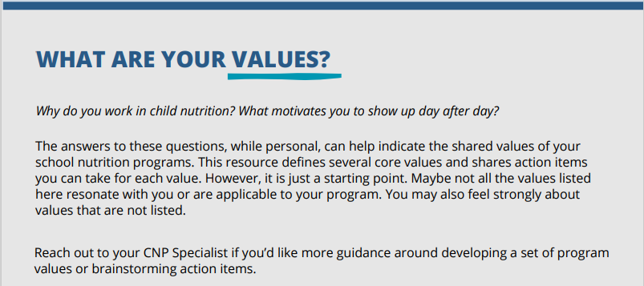
Value Based Scoring
MPS Selection Criteria
Strategy to compare bids based on Farm to School values
Developed in partnership with USDA
Scoring system creates multiplication factor to apply to each farm’s bids
High quality produce – 20%
Food Safety – 20%
Customer Service – 15%
Sustainability – 15%
Equity & Diversity – 10%
Organizational capacity –10%
Community & Value Alignment –10%
Notes:
BW

Slide 22
Benefits of Forward Contracting
for Schools:
Ensures supply of desired products
Time for on-boarding and training
Menu planning
Choice in suppliers/farms
Long-term partnerships
for Farms:
Ensured outlet for produce
Time for sufficient planning
Specialize in specific items
Investment in farm
Long-term partnerships
Access to a meaningful market
Notes:
BW
Ensures supply of desired products and volumes
Especially helpful for items that you are looking to purchase in larger volumes
Time for on-boarding and training
Provides time to meet with farmers to explain the Farm to School program, review food safety plans, conduct site visits, etc.
Menu planning
Choice in suppliers/farms
Will likely provide access to different farms than you have access to through general produce distributors
You can identify farms who share values with your district, have the experience level you are seeking, etc.

Slide 23
Our Best Practices for Successful Forward Contracting
Think about what items make sense for your contract
Set reasonable expectations with farms through RFP
Build relationships!
- Take time to get to know the farmers and understand their operations
Improve your process from year to year
Notes:
BW & Ariel

Slide 24
Thank you!
Farmer Profile Video

Slide 25
Values Oriented Micropurchasing
Jo Dawson, MS, SNS
Child Nutrition Consultant
Notes:
AN INTRODUCTION TO VALUES-BASED CHILD NUTRITION:
START SMALL
Making the shift towards values-based procurement is a big change and can be overwhelming (or downright impossible) if you try to do everything all at once. Start by choosing one or two of the values that are most important to you and exploring action items in those categories.
Micropurchases are a great way to explore values-based procurement without needing to revamp your entire formal contracting process. If you can make even a handful of meaningful micropurchases a year, you’re on the path to a new style of procurement. It’s always a good time to turn our good intentions into action.

Slide 26
SFA Purchasing Power
Myth: Specialized procurement is for medium & large SFAs with an administrative infrastructure
Reality: It’s easier to turn a small boat than a large ship
Notes:
Myth: Specialized procurement is for medium & large SFAs with an administrative infrastructure
Help is coming in this regard - USFA Cooperative Agreement – improving school nutrition procurement for SFAs of all sizes
eBid system that will help
Tools for working with local producers
Reality: It’s easier to turn a small boat than a large ship
You are less likely to have to go thru many stages of bureaucracy to make the changes you want
The power of the pivot

Slide 27
Advantages of Small SFAs
More likely to know your local growers
Micropurchasing is more meaningful
Limited by the threshold
More able to manage the processing the purchase without need of a distributor and/or processor
Notes:
Being a small SFA can be your super power -
More likely to know your local growers, producers, processors
Able to plan annually benefiting the grower/supplier and the SFA
Micropurchasing is more meaningful
Schools should always defer to their local procurement thresholds and processes, which could be more restrictive than the State's requirements.
If their LEA defaults to the state guidance, the state's guidance is
$5k (individual item threshold)
$10k (aggregate threshold -multiple items costing less than $5k)
and the annual cumulative threshold ($50k) per Utah Administrative Code Title R33 (Procurement Rules).
The $50k cumulative annual threshold is what the schools have to work within when making small purchases with a single producer. For example, they may purchase independent items or multiple items (in a single transaction) with a single producer up to an annual volume of $50k without having to competitively procure (formal solicitation) the items it has received from that producer once that threshold has been exceeded
Limited by the threshold (assuming federal); that size purchase means more to your food service
$5000 may not be a large portion of your budget but may make a very big difference to the small producer’s income.
Able to plan annually benefiting the grower/supplier and the SFA
More able to manage the processing the purchase without need of a distributor and/or processor
i.e. more capacity to manage unwashed carrots then a large SFA may have

Slide 28
Micro-Purchase Thresholds
In Utah
$5,000 maximum per item
$10,000 maximum per purchase
$50,000 cumulative annual threshold
2 CFR Part 200.67 and 2 CFR Part 200.320
Aggregate dollar amount does not exceed the micro-purchase threshold.
Distribute micro-purchases equitably among qualified suppliers.
May be awarded without soliciting competitive quotations if the price is considered reasonable.
Best practice: include in the procurement plan.
Notes:
The process begins by asking if the single, aggregate purchase is equal or less than the micropurchasing threshold. If so it may be considered a micro-purchase. To the extent practicable, micro-purchases must be distributed equitably among qualified suppliers and may be purchased without competitive price quotes as long as the price is considered reasonable by the entity doing the purchase.
Purchases may not be split for the deliberate attempt to make each purchase below the micropurchasing threshold. Program operators may get a better price if they use another method that allows for more competition. They are not obligated to choose the micro-purchase method.
As a best practice, this should be included in the procurement plan.
Schools should always defer to their local procurement thresholds and processes, which could be more restrictive than the State's requirements. If their LEA defaults to the state guidance, the state's guidance is $5k (individual item threshold), $10k (aggregate threshold -multiple items costing less than $5k), and the annual cumulative threshold ($50k) per Utah Administrative Code Title R33 (Procurement Rules).
The $50k cumulative annual threshold is what the schools have to work within when making small purchases with a single producer.
For example, they may purchase independent items or multiple items (in a single transaction) with a single producer up to an annual volume of $50k without having to competitively procure (formal solicitation) the items it has received from that producer once that threshold has been exceeded.

Slide 29
Local - Traditional - Indigenous - Values-Based
Notes:
Photo Credit: Alaska Dispatch News
Like most states, local foods, farm to school, fish to school have been a significant interest,
Traditional food – traditional values
Local: Carrots, barley
Traditional: Seafood – salmon, pollock, halibut, berries
Indigenous: beach asparagus, herring eggs
Values Based – your distributor is not likely to carry most of these – some local – so as you look at vendors, you are able to incorporate your values based purchasing.

Slide 30
Myths on Supply v Regulations
School Food Service Staff
Supply
Student Preference
Federal & State Regulations
Cost
Kitchen Equipment & Recipes
Non-School Food Service Staff
State and Federal Regulations
Supply
Cost
Kitchen Equipment
Student Preference & Recipes
Notes:
More myths v reality

Slide 31
Definition of Traditional Food
Farm Bill Definition
TRADITIONAL FOOD.—
(A) IN GENERAL.—The term ‘‘traditional food’’ means food that has traditionally been prepared and consumed by an Indian tribe.
(B) INCLUSIONS.—The term ‘‘traditional food’’ includes—
(i) wild game meat;
(ii) fish;
(iii) seafood;
(iv) marine mammals;
(v) plants; and
(vi) berries
Notes:
There is a misperception that our programs cannot accept traditional foods, I like to refer back to the definition provided in the Farm Bill and ask which traditional foods we cannot accept? Generally in Alaska even the food items (either fermented or from wild game) that are disallowed by the food safety program, may be allowed through a variance process; the next step is working with USDA. The RD at our USDA regional has always been great at working with our office when we get requests for credibility of traditional foods. Overcoming the perception that traditional foods are not allowable and creditable is difficult.

Slide 32
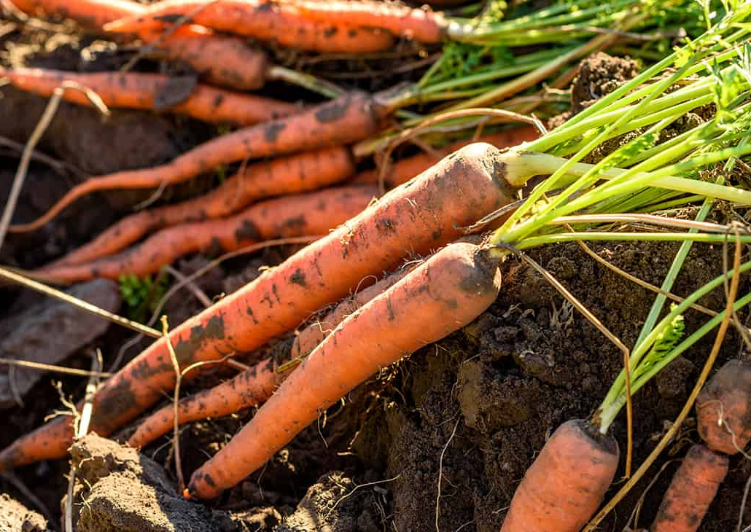
Local Produce
Start small
Develop relationship
Plan forward
Notes:
Carlee McIntosh: We work closely with out only farmer here in Petersburg.
The relationship started off with us buying left over product from farmers market.
We used it primarily in the Summer Food Program. Now that we have built a relationship we have an entire bed of carrots that they grow exclusively for the school. This allows us to plan into October for Local product.
The quality is by far better than anything we can get through US Foods.
With our relationship we are starting to explore more partnerships with farmers from other islands to work on transportation of products via sports travel.
The product last longer than commercial products and we are able to process and freeze anything that may not.
We set aside about $5000 a year just for local.
This is not a lot for us but huge for our partner.
We also still buy left over items from farmers market for salad bars and SFP
This is very micro purchase compared to our US Foods budget. However, it is huge to our farmer! They can rely on us year after year in an unstable world

Slide 33
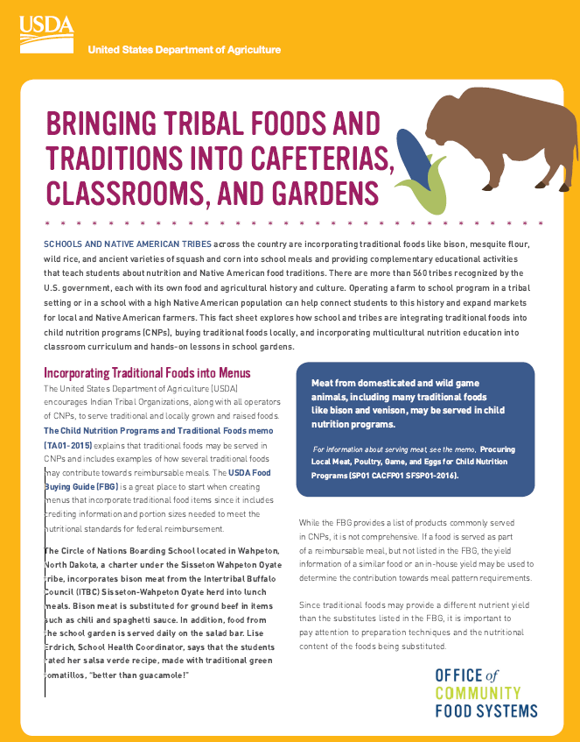
Micropurchasing Traditional Foods
Notes:
Photo Credit: Associated Press
Alaska Gateway SD brough class to select Bison which became part of their lunch program

Slide 34
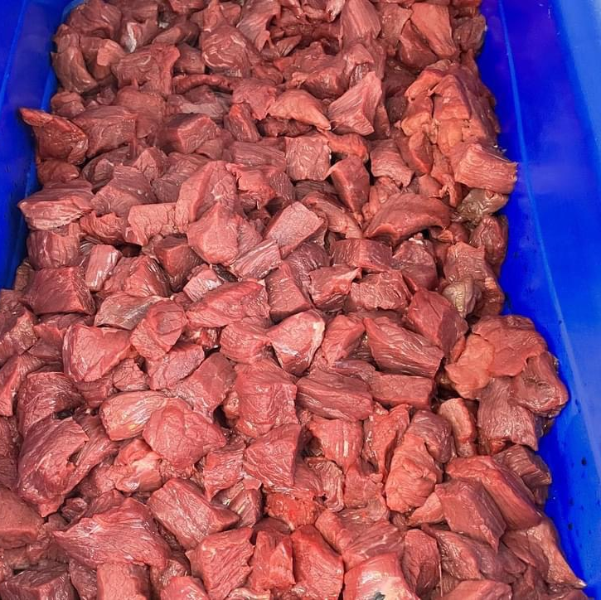
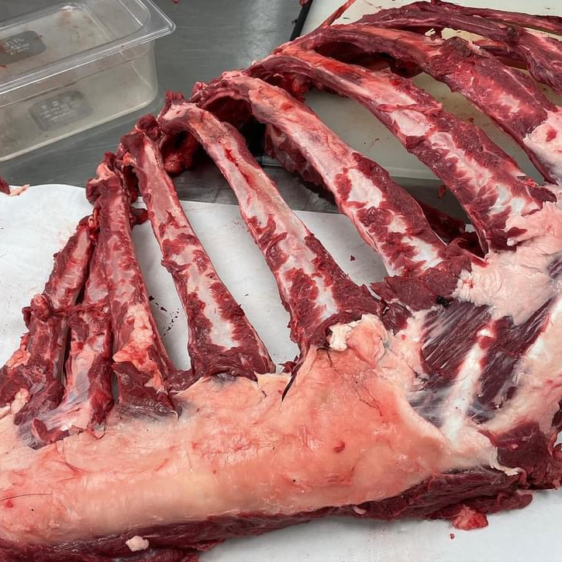
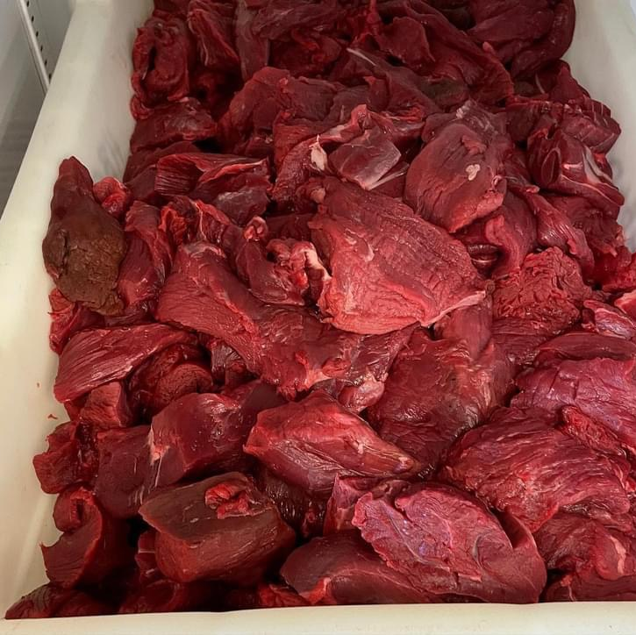
Donation plus Costs
Moose Harvesting
Notes:
Explain Fish and Game confiscation program
Some SFAs gain a variance thru DEC to process, others have processed commercially – all within Micropurchasing

Slide 35
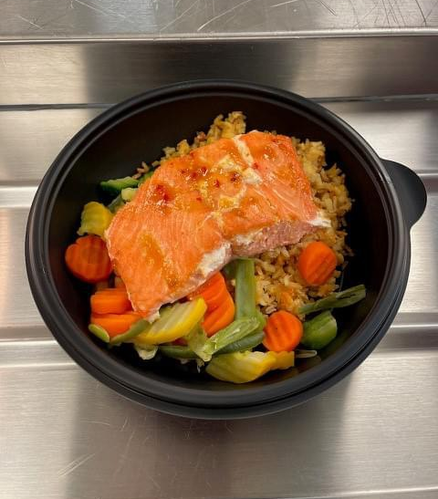
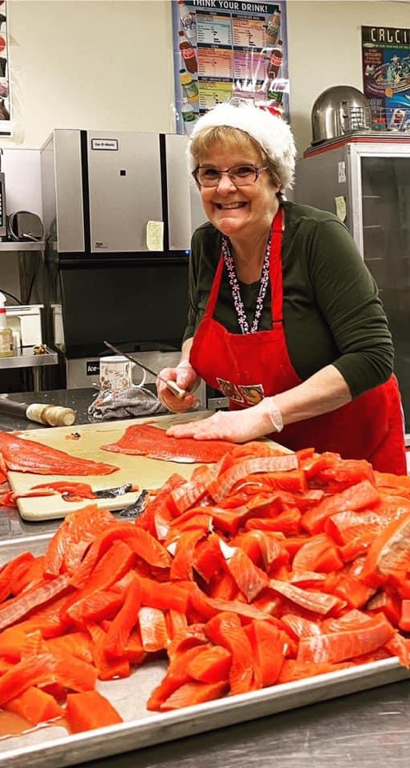
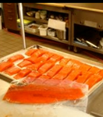
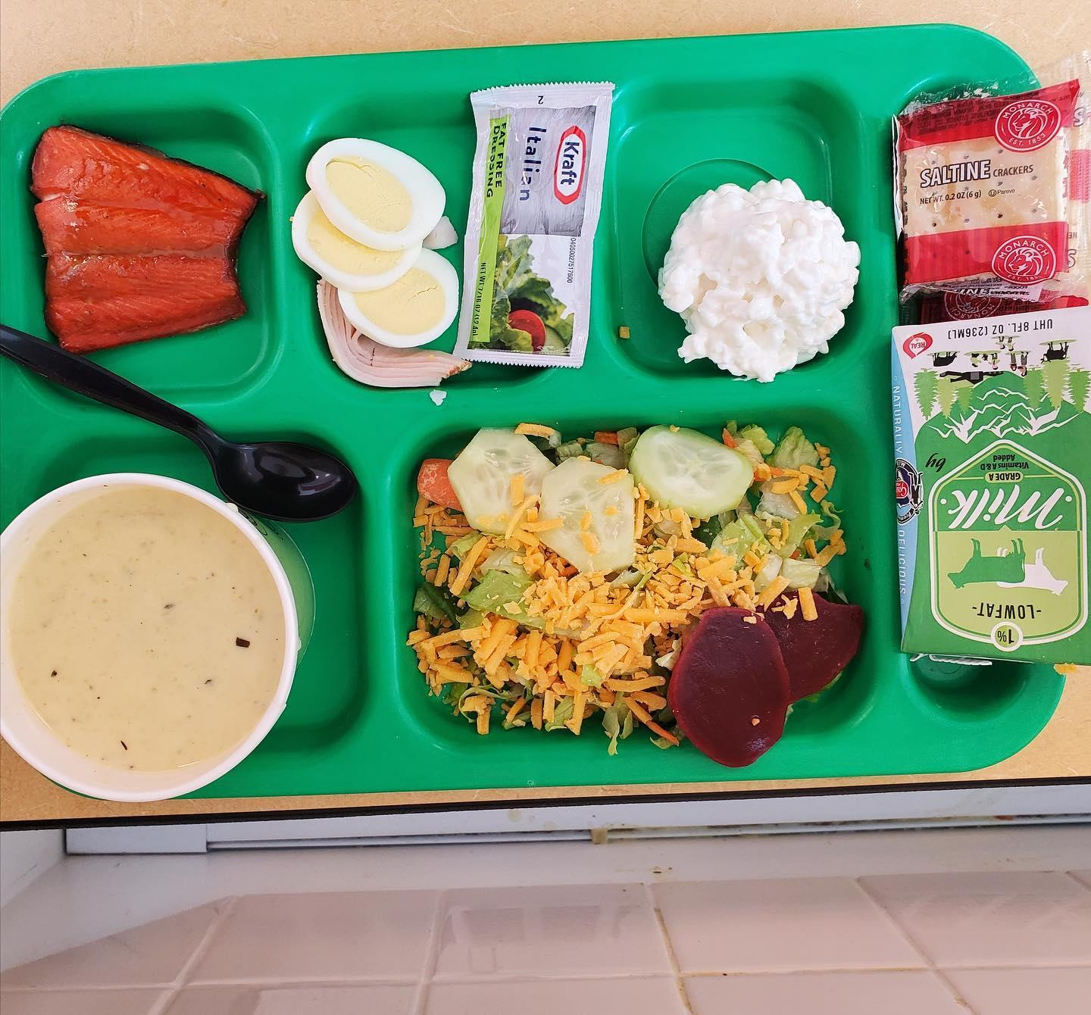
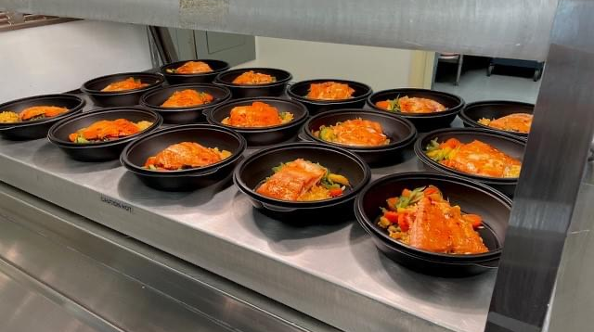
Donation plus Costs Salmon Programs
Notes:
Knowing that supply is the biggest issue for us, commercial sources have been the way to ensure that traditional foods are provided in school meals. One of our best examples of “out of the box” thinking started in 2009 by Patty Lukhurst here in Dillingham, Alaska.
Dillingham is a remote Alaskan community of 2,500 residents. There are no roads to this fishing town 365 air miles southwest of Anchorage, so most resources need to be brought in by barge or plane. Air freight from Anchorage costs $1 per pound, which escalates the cost of food dramatically. Local fishermen for donations as they unloaded their catch. The Peter Pan cannery would donate the labor-intensive and messy job of gutting, filleting, pin-boning, vacuum packing and flash-freezing the fish for the school district. School Food Service Manager, Patty Luckhurst and Peter Pan Seafood Processing marketed the Fish for Kids program by designating donation days during the short sockeye season. This program began in 2007 and still continues. Annually approximately 12,000 pounds of donated sockeye are received and processed it into flash-frozen fillets. Families are invited to have lunch with their children on Fridays and partake in the meal. This program has instilled a lot of community pride because families are contributing in such a meaningful way. So much salmon is received that this fish is also shared with the Southwest Region School district, area head start agencies and a senior center.
While this is one of two donation program currently, several Alaskan school districts now have close partnerships with local fish processing to provide strong fish to school programs.

Slide 36
Fish To School – Alaska Resources
Notes:
Fish is a cornerstone in Alaska, of our diet and our economy. However, making the transition for schools from processed fish to local processed created a need for resource materials in procurement, cooking, and serving. The Purchasing guide also describes establishing donation programs.

Slide 37
USDA Regional Support
Beach Asparagus
Nutritional Specifications
Alaska Harvest of the Month
Notes:
Just because it’s not in the Food Buying Guide, does not mean it’s not allowable
Beach asparagus – nutritional specs thru USDA,
included in the Alaska Harvest of the Month

Slide 38
Notes:
As a pleasant surprise, when I was prepping for this presentation, I saw that the Petersburg School Distict, a new Health Meal Incentives Recognition Award, highlighted beach asparagus as part of their application, full circle moment for me.
They also serve herring eggs, salmon and moose.

Slide 39
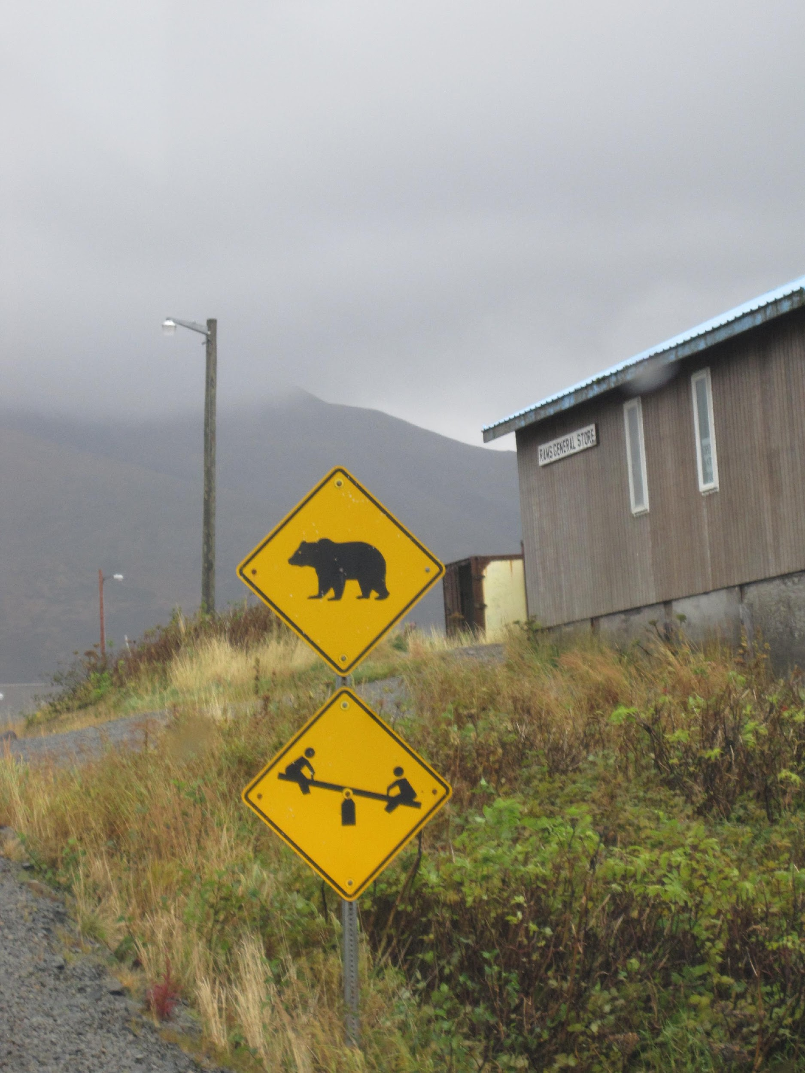
Values Oriented Micropurchasing
Jo Dawson, MS, SNS
Child Nutrition Consultant

Slide 40
UTAH PANELISTS
Kelly Orton, SFS, MBA, Director of Child Nutrition, Salt Lake City School District
Paula Loveland, CNP Supervisor, Iron County School District
Marci Johnson, Foods Director, Reagan Academy

Slide 42
Marci Johnson
Foods Director at Reagan Academy, Springville UT
Bids Manager for the Charter Co-op of Utah

Slide 43
What is value based procurement?
Value-based procurement, also known as “best value’ procurement, means evaluating purchases beyond the purchase price. It is a purchasing model that can be used to align your program’s values and needs with your vendors.

Slide 44
Charter School
&
Charter Co-op of Utah

Slide 45
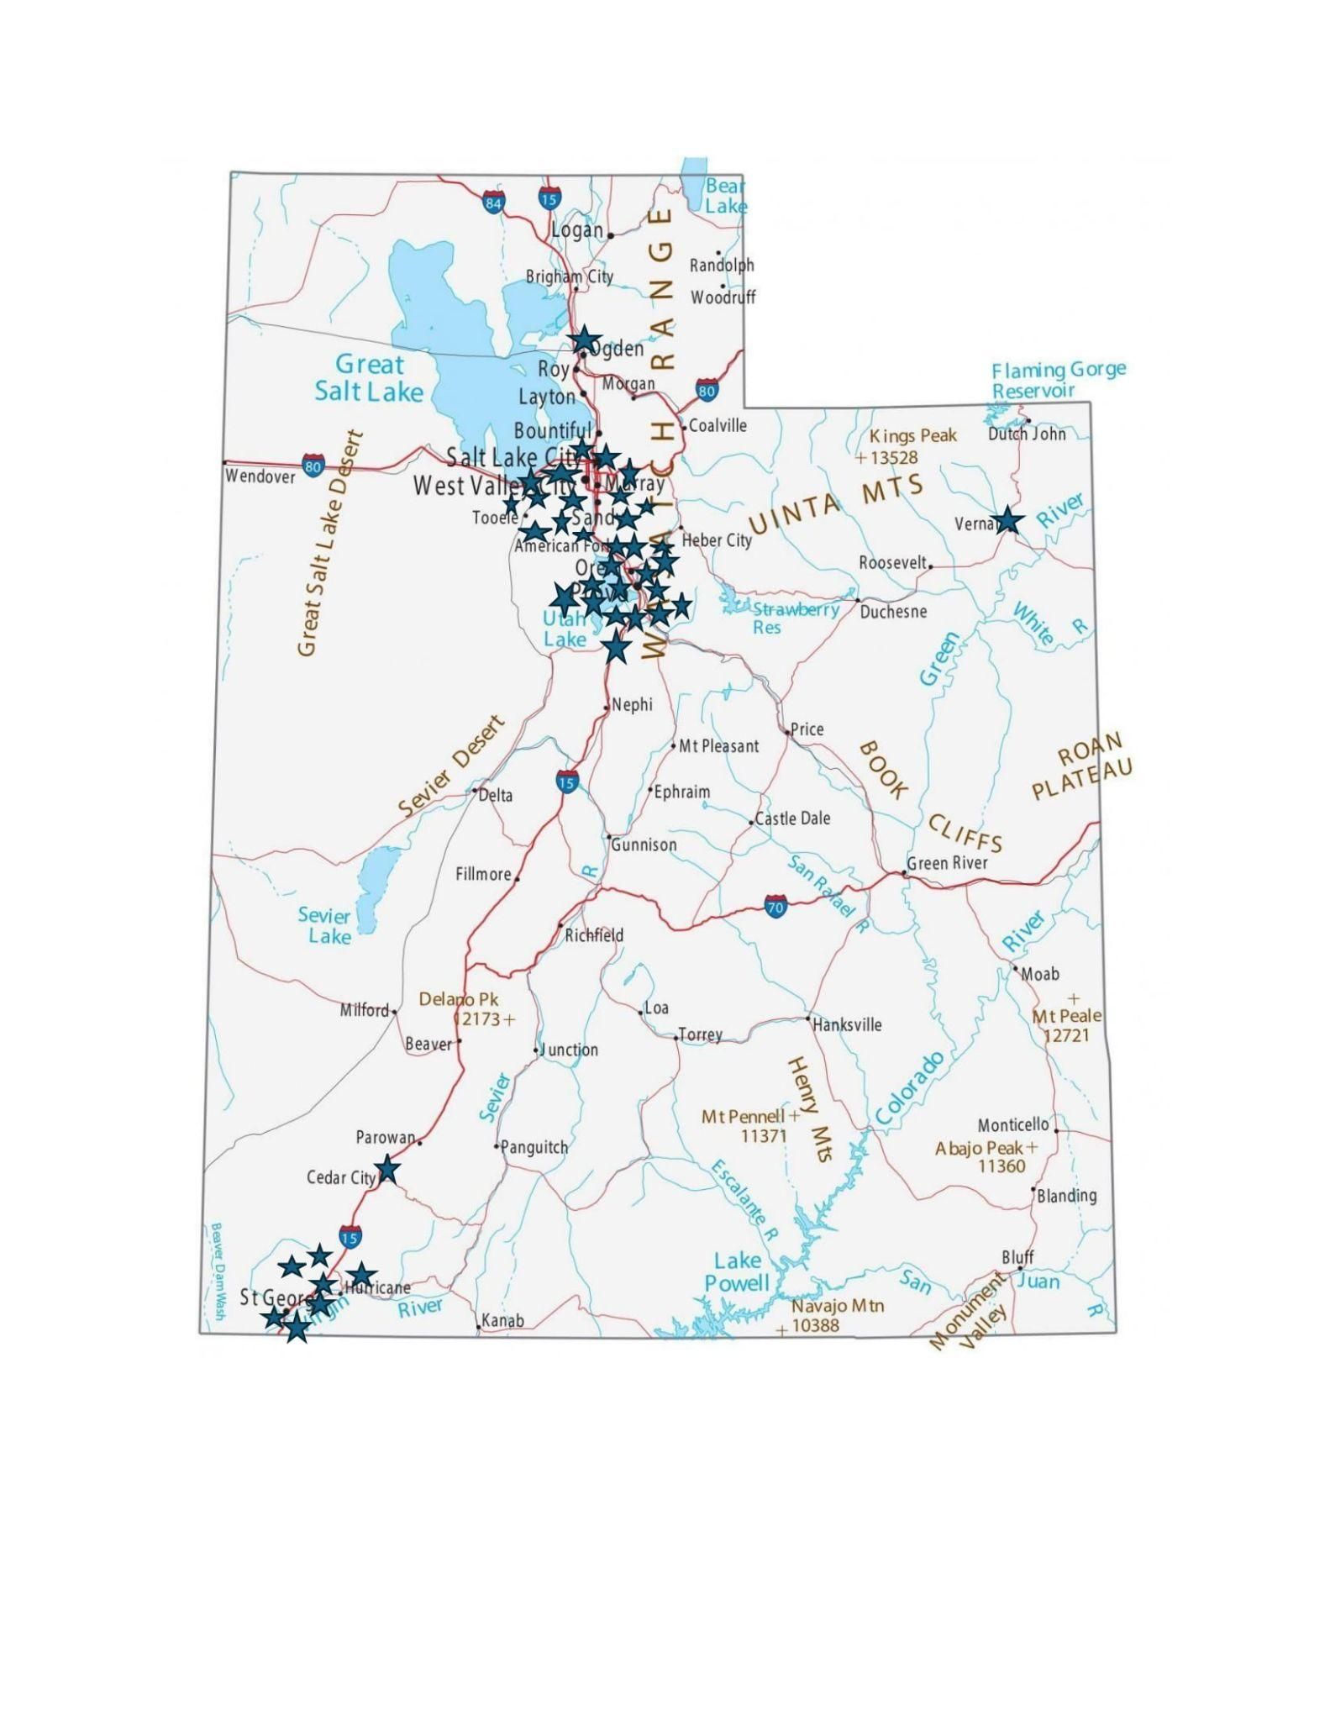

Slide 46
mjohnson@reaganacademy.org

Slide 47
BREAK
10:45 AM - 11:00 AM

Slide 48
QUESTIONS FOR WORKGROUPS
Define Value Based Procurement
How do you define value-based procurement?
Write down some ideas and share them with your partner.
Is your definition different than your partners?
Let’s hear a few definitions. Does anyone want to share their idea?
Refine your own definition
Identify what you are already doing in procurement that meets your definition – this is your story today.
What would you like your story to say? Let's start planning for tomorrow.
Using your definition, make a list of values you would like to start enhancing in your procurement process.

Slide 49
QUESTIONS FOR WORKGROUPS
Menu Item Identification
Using your definition and values list as a reference, take a look at your bid.
Are there any values already embedded in the bid? .
Are some of the items on the menu purchased with other values in mind?
Pick two new items that would be good places to start adding value-based language.
Working with your partner, start writing some sample value-based language that you use to enhance the quality of these menu items.

Slide 50
LUNCH
12:00 PM - 1:00 PM

Slide 51
VALUE-BASED
PROCUREMENT LANGUAGE
Continue writing value-based language for your next solicitation.
What language have you developed?
How will this enhance your value-based procurement?
Thinking of outside stakeholders, who might be good partners in this work?
Who can you get to support this type of procurement?

Slide 52
QUALITY VS LOWEST PRICE
Overview of quality vs lowest price
Procurement Checklist
Expert panelists weigh in on this issue

Slide 53
BREAK
2:30 PM - 2:45 PM

Slide 54
DEVELOPING SCORING PERCENTAGE FOR QUALITY, VALUE-BASED FOOD SUPPLIES
What scoring percentage would you give each item in your solicitation?
Please remember that the price has to be the highest percentage but does not need to be more than 50%.
What language have you developed that will help you enhance your value-based procurement and what scoring percentage did you put for each item?

Slide 55
CALL TO ACTION
Thank you for participating. Stay in touch with the USFA and our USDA Cooperative Agreement
on our website!
WEBSITE:
urbanschoolfoodalliance.org/cooperativeagreement

Slide 56
USDA RESOURCES
Procuring Local Foods Guide | Food and Nutrition Service (usda.gov)
Local Procurement Decision Tree | Food and Nutrition Service (usda.gov)
Integrating Local Foods into Child Nutrition Programs | Food and Nutrition Service (usda.gov)
Geographic Preference | Food and Nutrition Service (usda.gov)
10 Facts About Local Food in Schools | Food and Nutrition Service (usda.gov)
Local Meat in Schools | Food and Nutrition Service (usda.gov)
USDA Foods: A Resource for Maximizing Food Budgets To Buy Local | Food and Nutrition Service
USDA DoD Fresh Program: A Source for Locally Grown Produce | Food and Nutrition Service

