Slide 1

New York City Department of Education
Office of Food and Nutrition Services
Emergency Meal Readiness

Slide 2
Emergency Meal Readiness
Why
  Needed a cost neutral plan for Y2K in 1999.
  Primary emergency food responder for New York City.
  Allows continuity of service for both small and large scale events
    Building relocations / Power Outages
    Coastal Storm Planning
    Mass Evacuation or Vaccinations
  Gives a buffer for supply chains to recover.
How
  Determined suitable items
  Developed with the NYC Office of Emergency Management
  Nutrition analysis conducted
  Utilized and improved several times

Slide 3
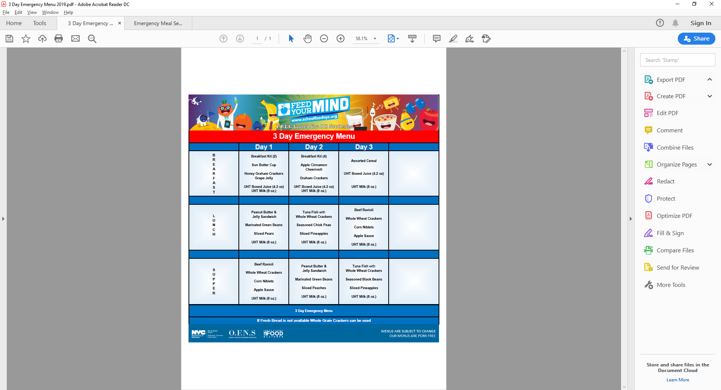
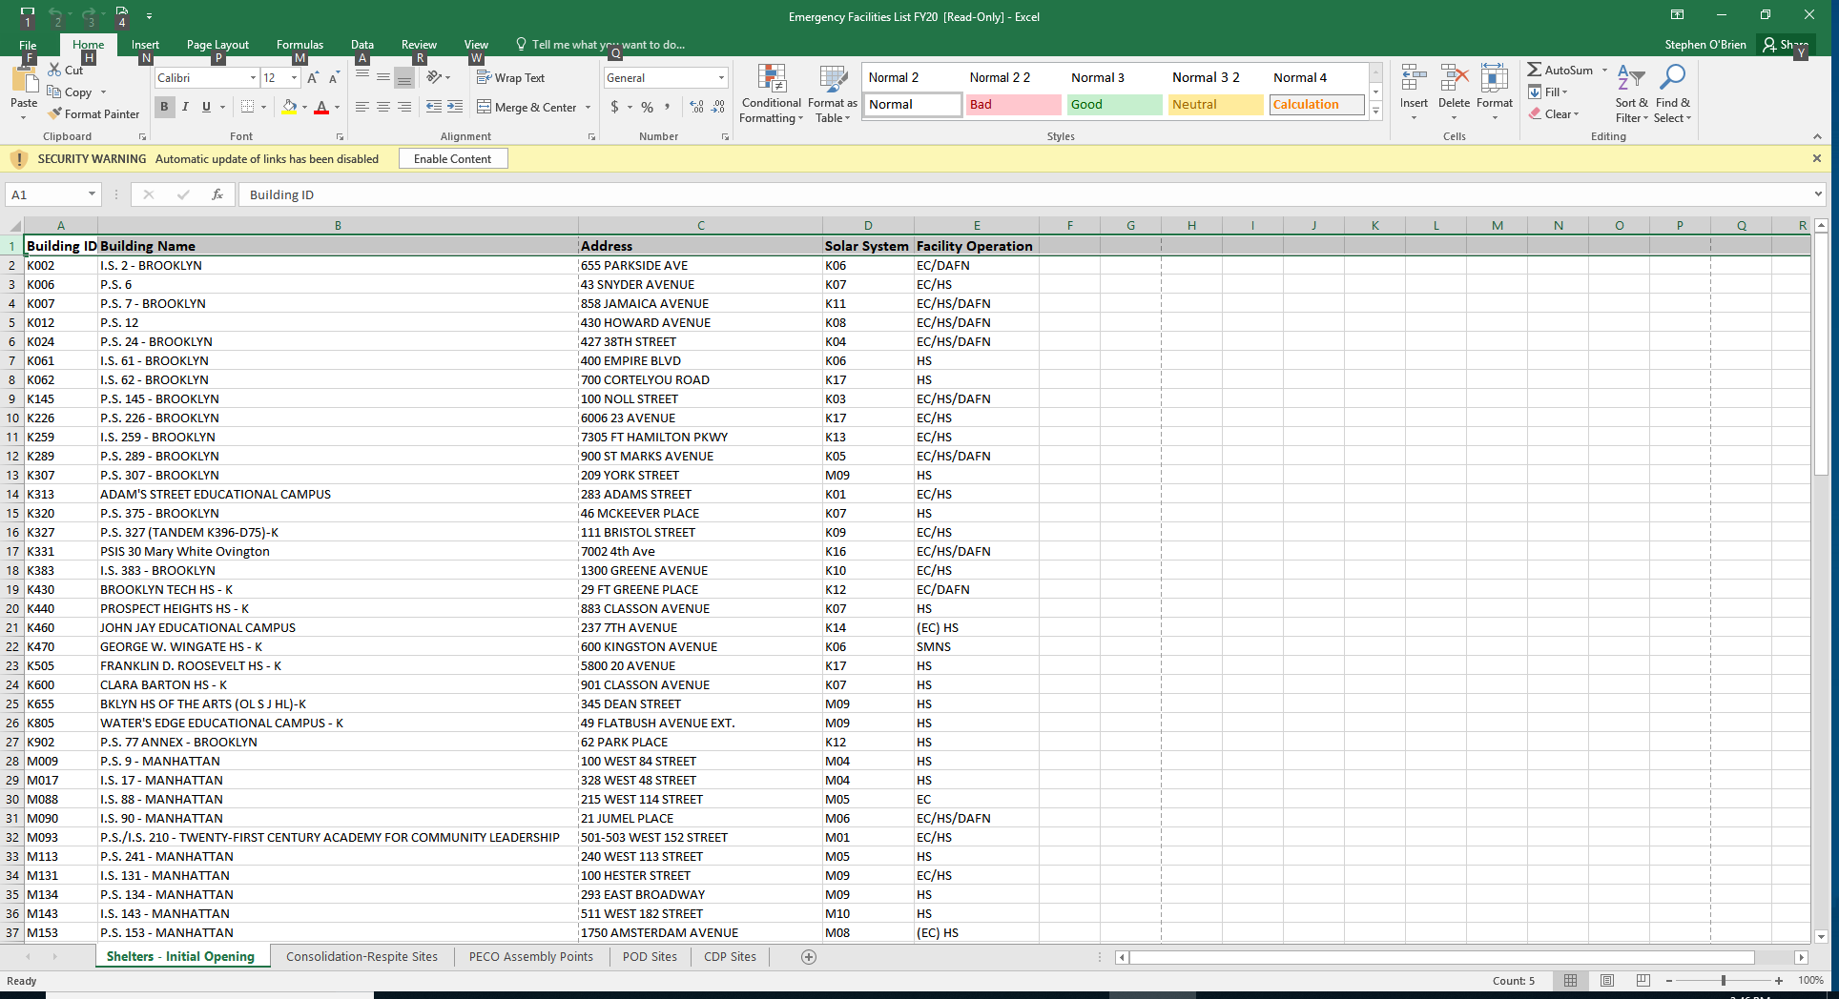
Emergency Meal Readiness
Menu
Memo
Sites

Slide 4
Emergency Meal Reediness
Maintenance
  Annual review of sites conducted with multiple offices and agencies
  Supply Chain follow ups conducted periodically
  Reminders to have stock on hand done during inspections and periodically.
Questions and Answers
  sobrien@schools.nyc.gov or sobrien@urbanschoolfoodalliance.org
THANK YOU!

