Slide 1
Urban School Food Alliance
February 7, 2024
Dinner and a Show
Leadership Summit
July 27, 2023

Slide 2
How Full Is Your Bucket?
Presentation By:
Allison Monbleau & Maggie Prieto
The School District of Palm Beach County
Notes:
Hello Everyone. I am Allison Monbleau from The School District of Palm Beach County
…And I am Maggie Prieto also from the School District of Palm Beach County
Our presentation today is called How Full Is Your Bucket, but before we get to that we would like to do a little icebreaker.
We will be using the Mentee app throughout our presentation tonight. Please use the QR code to access the app.

Slide 3
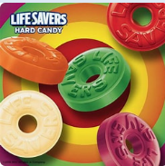
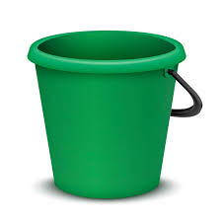
How Full Is Your Bucket
Ice-Breaker
Life Savers
Notes:
To learn a bit about each other we would like to open with a lifesaver ice-breaker.
Please take one life saver each out of the bucket on your table, but don’t eat it or unwrap it yet.
Ok. Does everyone have a lifesaver?

Slide 4
Would You Rather… and Why?
Yellow - Hike in the Woods or Lay on the Beach
Orange - Go on a Cruise or Travel in a Car Across the Country
Green - Visit a Family Member or Have them Visit You
Purple - Live in the City or the Country
Red - Take a Walk in the Rain or the Snow
Notes:
Now you are going to go around the table and let everyone know which you would rather do depending on the color of the life saver you have in front of you.
If you have yellow, you will share if you would rather hike in the woods or lay on the beach. And also explain why you chose that option. After you have gone around the table once and you have had an opportunity to share, please shift the lifesavers to the right one time and share out again.
5 minutes

Slide 5
How Full Is Your Bucket
By
Tom Rath and Donald O.Clifton, Ph.D.
Notes:
We hope you had fun with that ice-breaker.
Our presentation today is on the book - How Full is your Bucket by Tom Rath and Dr. Donald O. Clifton.
In Palm Beach County we have annual retreats with our Central Office Team and this is a book we highlighted one year for our retreat. We hope you enjoy this training.

Slide 6
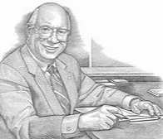
Who Was Donald O. Clifton?
1950’s - University of Nebraska psychology professor
1960’s - 1980’s - Researched “what is right with people”
2001 - Wrote the book “Now Discover Your Strengths
2002 - Recognized by the American Psychological Association as the “Grandfather of Positive Psychology and the “Father of Strengths Psychology”
Notes:
So who was Dr. Donald O. Clifton?
Dr. Clifton began his career as a psychology professor at the University of Nebraska. At that time psychology was solely focused on what was wrong with people and that did not set well with him. He began to look into what is right with people and focused on the positive as opposed to the negative.
In 2001 her wrote the book “Now Discover Your Strengths” which is another great book that I recommend you taking the time to read. It also have a strengthsfinder activity in the book that is great
Because of Dr.Clifton’s insights and research he was named the Grandfather of Positive psychology and the Father of Strengths Psychology.
Tom Rath, the co-author of the book was a mentee and friend of Dr. Clifton.

Slide 7
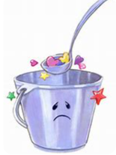
The Theory of the Dipper and the Bucket
Each of us has an invisible bucket.
Each of us also has an invisible dipper.
A full bucket gives us a positive outlook and renewed energy.
An empty bucket poisons our outlook, zaps our energy, and undermines our will.
Every moment of every day we have a choice:
We can fill one another’s buckets, or
We can dip from them.
Notes:
What is the theory of the dipper and the bucket? The theory of the bucket is that each of us has an invisible bucket. It is constantly emptied or filled, depending on what other say or do to us. When our bucket is full, we feel great. When it’s empty, we feel awful.
Each of us also has an invisible dipper. When we use that dipper to fill other people’s bucket – by saying or doing things to increase their positive emotions – we also fill our own bucket. But when we use that dipper to dip from other’s bucket – by saying or doing things that decrease their positive emotions – we diminish ourselves.
Like the cup that runneth over, a full bucket gives us a positive outlook and renewed energy. Every drop in that bucket makes us stronger and more optimistic.
But an empty bucket poisons our outlook, zaps our energy, and undermines our will. That’s why every time someone dips from our bucket, it hurts us.
So we face a choice every moment of every day: We can fill one another’s buckets, or we can dip from them. It’s an important choice – one that profoundly influences our relationships, productivity, health, and happiness.

Slide 8
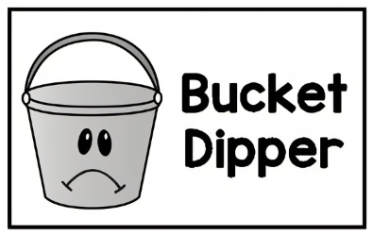
Bucket Dipping
Bucket Dipping can have a terrible impact.
Notes:
Bucket Dipping can have a terrible impact on us emotionally and physically. Dr. Clifton examined a case study about prisoners of war during the Korean War. The prisoners had food, water and shelter and were not tortured, yet many prisoners died in these camps; more than in any other war.. The North Koreans utilized bucket dipping tactics to keep soldiers in a depressed state and under their control.
The North Koreans would withhold any mail with positive messages from home while letting the mail with bad news like home foreclosures be read.
They also had prisoners share in open forums the things they did in their life that the regretted to have them be seen in a bad light to their fellow prisoners.
Also prisoners were rewarded with cigarettes by tattling on fellow prisoners.
Each tactic was dipping into the prisoners buckets. In the end, prisoners were so depressed that they would not try to escape if the opportunity arose, wouldn’t help each other out, even if their lives were at stake, and those who came home could not maintain friendships.

Slide 9
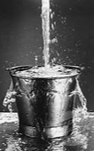
Bucket Filling
Recognition and Praise
Productivity
Engagement
Retention
Customer satisfaction
Safety
Notes:
Bucket Filling, on the other hand, can have a positive impact on us emotionally and physically. Studies show that recognition and praise in a work environment can:
Increase individual productivity
Increase engagement among their colleagues
Staff are more likely to stay with their organization
The companies receive higher loyalty and satisfaction ratings from their customers
The companies have better safety records and fewer accidents on the job

Slide 10
What is the #1 Reason People Leave their Organizations?
Notes:
What is the #1 reason people leave their organization?
Mentee

Slide 11
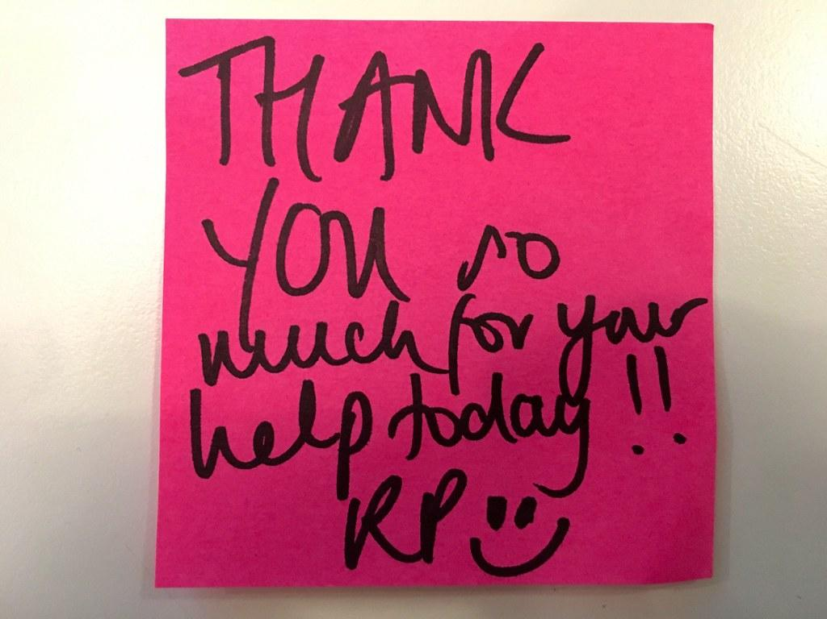
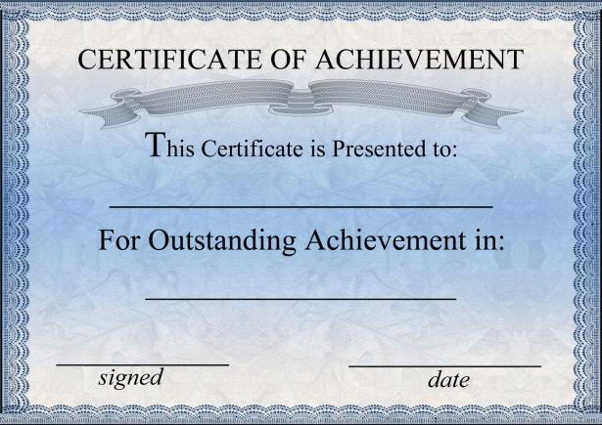
They don’t feel appreciated
Notes:
It is because they don’t feel appreciated.
One study even found that employees working for a boss they didn’t like had higher blood pressure.

Slide 12
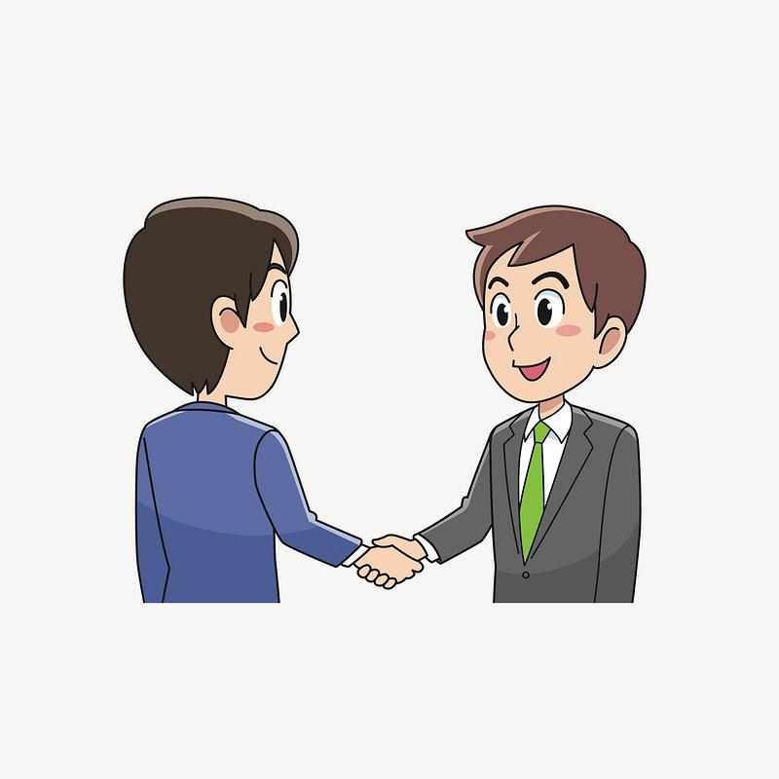
Bucket Filling
Every Moment Matters
Brief Interactions
Positive Energy
Notes:
So how do we fill others buckets?
Brief interactions during the day provide opportunities to fill others buckets. Just saying hi or commenting on something they did that you appreciate can fill their bucket.
In fact just the act of how you are greeting people can either be bucket dipping or bucket filling.
We are going to do a quick exercise..
Please turn to your neighbor and say hi to them as if they were your worst enemy and you don’t want to be around them.
How did that feel? (uncomfortable, made you sad or irritated)
If you were greeted that way in the morning, would it set you up to have a great day? Probably not.
Ok, Now turn to the same person and act as if they are your long lost friend who you are so happy to see.
Did you feel differently? If you were greeted with this enthusiasm in the morning, as opposed to indifference or negative energy, you would probably respond differently.
Super…Thank you for participating.
Every interaction we have with others brings with it either positive or negative energy and that energy impacts the participants and can also impact those around them.
Negative people and interactions dip from your bucket.
Positive energy helps to fill others buckets and can also fill your bucket. In fact 9 out of 10 people reported that they were more productive if they were around positive people.
Positive emotions can improve our daily physical and mental well being.

Slide 13
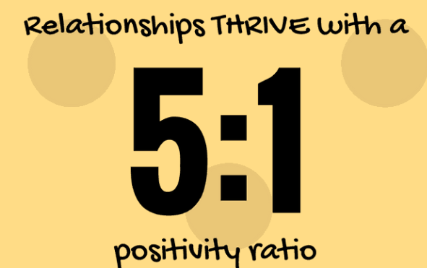
The Magic Ratio
5 positive interactions for every 1 negative interaction
You get more of what you focus on… to a limit
More than 13 positive interactions for every one negative interaction could decrease productivity
Notes:
So you have heard that positive energy can have positive results on people and organizations, but let’s take a deeper look into that.
Dr. Clifton found that there is actually something he termed as the magic ratio. If you interact with someone and for every positive interaction there is one negative interaction, that relationship will statistically not survive. Whereas if you interact with them and for every 5 positive interactions there is only 1 negative interaction, the relationship will survive.
So the more positive interactions the better… right?
Actually no. It was also found that if you only have 1 negative interaction for every 13 positive interactions, productivity and relationships could suffer. Being too positive and never discussing or focusing on the negative can have a detrimental effect as well. Most people don’t have to work very hard to find areas where improvement is needed so this is rarely an issue, but something to be aware of.

Slide 14
5 Strategies for Increasing Positive Emotions
Prevent Bucket Dipping
Shine a Light on What Is Right
Make Best Friends
Give Unexpectedly
Reverse the Golden Rule
Notes:
So you have heard a bit now about why filling peoples buckets as opposed to dipping from their buckets is important.
And now Maggie is going to go over some strategies to put bucket filling into action.
There are 5 strategies we will review
Prevent Bucket Dipping
Shine a Light on What is Right
Make Best Friends
Give Unexpectedly
Reverse the Golden Rule

Slide 15
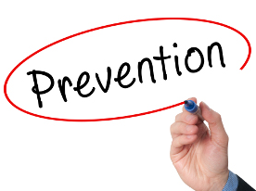
1 - Prevent Bucket Dipping
In each interaction, are you adding or taking from the other person’s bucket?
Push the “pause” button
Convince others that unwarranted negativity only makes matters worse.
Keep track of your interactions and progress.
Notes:
Preventing Bucket Dipping.
This is very important and a great place to start because it is hard to fill a bucket if you are constantly dipping from it.
Ask yourself when you have interactions. Am I adding to this person's bucket or taking from it? Take the time to evaluate your interactions.
Next is to pause before you have an interaction. Were you going to poke fun at someone? were you going to call them out in front of others? These would be actions that would be bucket dipping and perhaps you should pause and reconsider.
Next is to keep track of your interactions and progress. This could be jotting down the positive and negative interactions with each person, or just taking a mental note. Are you reaching the magic ratio with those you are coming in contact with?

Slide 16
2 - Shine a Light On What is Right
Focus on the positive rather than dwelling on the negative.
Never underestimate the long-term influence of filling others’ buckets.
Positive emotions create chains of interpersonal events.
Every time you fill a bucket, you’re setting something in motion.
Notes:
The next strategy is to shine a light on what is right. People like to know that they are meeting or exceeding expectations and that they are appreciated for what they do.
Focus on the positive rather than dwelling on the negative.
Never underestimate the long-term influence of filling others’ buckets.
Positive emotions create chains of interpersonal events.
Every time you fill a bucket, you’re setting something in motion.

Slide 17
2 - Shine a Light On What is Right
If you fill five buckets a day, and those owners fill five new buckets every day.
How many buckets would be filled after 10 days?
Notes:
If you fill five buckets a day, and the owners of those buckets go on to fill five new buckets, How many buckets would be filled by the end of 10 days?
Mentee

Slide 18
2 - Shine a Light On What is Right
Over 19 Million Buckets
Notes:
Answer: more than 19 million buckets would be filled in just 10 days.
On your table there is a Positive Impact Test that is in the book. You can take this after dinner or at a later time, but it might provide some insight as to where you are now with this strategy and what you might do differently to shine a light on what is right.

Slide 19
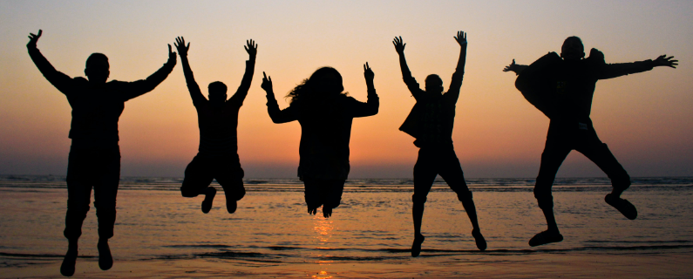
3 - Make Best Friends
Most of us have joined and stayed with groups, teams, and organizations because of our best friends.
People with best friends at work have better safety records, receive higher customer satisfaction scores, and increase workplace activity.
Your best relationships, began with positive interactions.
Fill a person’s bucket in your very first interaction.
Be the person who always notices when someone does a great job.
Notes:
The third strategy is to make best friends
Do you have best friends at your workplace? How do you think it affects your work environment?
When you think about organizations, clubs or even work. Most of us have joined and stayed with these groups because we have made a solid connection with others and have become best friends.
People with best friends at work have better safety records, receive higher customer satisfaction scores, and increase workplace productivity.
Your best relationships, begin with positive interactions and they don’t stop there. Make sure to listen to your friend unconditionally, support your friend in their endeavors and be the person they know they can always go to for a kind word.
Fill a person’s bucket in your very first interaction.
And be the person who always notices when someone does a great job.

Slide 20
4 - Give Unexpectedly
The vast majority of people prefer gifts that are unexpected.
This gift does not have to be tangible.
Something personal or entrusting a friend with a secret can fill his or her bucket.
Notes:
Strategy #4 is to Give Unexpectedly
Most people prefer gifts that are unexpected. You can light up someone's day with a small gift. Maybe a trinket, a hug, or an offer to grab a cup of coffee.
Even a smile can be an unexpected and cherished gift.
Sometimes just confiding in someone or taking a moment to share something about yourself could be a gift.
Or even entrusting them with a task or allowing them the opportunity for professional growth can fill their bucket..

Slide 21
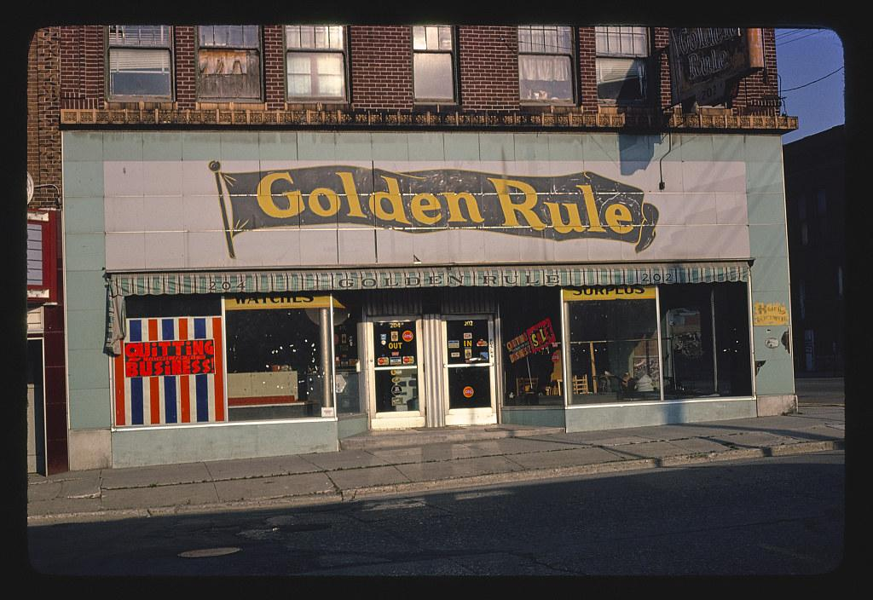
5 - Reverse the Golden Rule
What Is The Golden Rule?
Notes:
Can someone tell me What is the Golden Rule?
And no, I don’t mean that restaurant on the screen.

Slide 22
The Golden Rule
Notes:
Yes. The Golden Rule is to Do unto others as you would have them do unto you.

Slide 23
Reverse the Golden Rule
Do unto other as they would have you do unto them.
What we recognize in others helps them shape their identity and their future accomplishments. This is why bucket filling must be specific to the individual.
The bucket filling interview guide.
Notes:
Dr. Clifton believed that the Golden Rule did not go far enough for bucket filling. You want to do unto others as they would have you do unto them.
What is the difference? The golden rule assumes that what you like and how you want to be treated is what everyone likes and how they want to be treated.
In reality others may not like being noticed in public or to receive a note of thanks. It is important to recognize that we are each individuals with different likes and dislikes and to fill others buckets you will need to know what actions are bucket filling and what are bucket dipping for each person.
On the table you will find The Bucket Filling Interview. Completing this for yourself may give you ideas as to what you might want to ask of others to ensure you are taking the right action to fill their bucket.

Slide 24
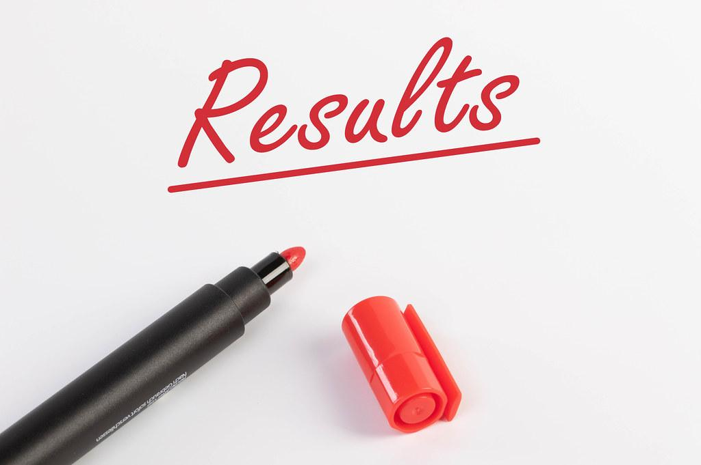
What will happen?
Your workplace will be a lot more productive and fun.
You’ll have more friends.
Your colleagues will be more satisfied and engaged.
You’ll enjoy closer relationships with your friends and family.
You’ll be healthier, happier, and well on your way to a longer life.
Notes:
So what results you may see if you start filling others bucket?
Your workplace will be a lot more productive and fun.
You’ll have more friends.
Your colleagues will be more satisfied and engaged.
You’ll enjoy closer relationships with your friends and family.
You’ll be healthier, happier, and well on your way to a longer life.

Slide 25
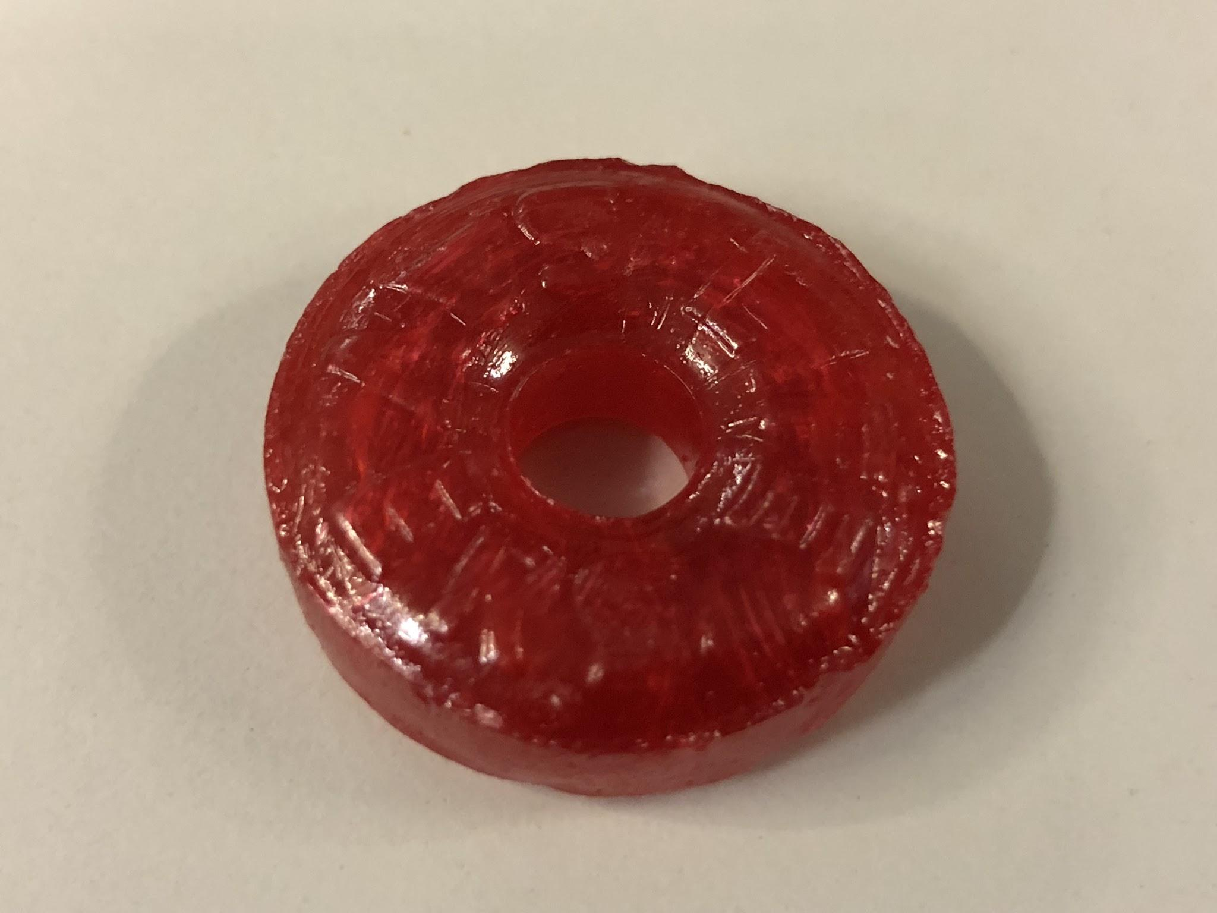
Optimistic Closing
Fill the Bucket Challenge - Part 1
Life Savers game
Notes:
We hoped you enjoyed our presentation today.
In Closing we have two Fill the Bucket Challenges for you.
The first one is a Life Savers game… not not that lifesaver
(Click mouse). Ah yes, that lifesaver.
This is a quick activity and we are going to need you to come up front and get into a line like you did last night for that bucket filling activity.
Each team will have a bucket of lifesavers and toothpicks. The goal is to pass the lifesavers from the staring person to the end on the toothpick and the last person will drop it in the bucket. The first team to finish should raise their hands and shout “USFA fills my bucket”

Slide 26
Optimistic Closing
Fill the Bucket Challenge - Part 2
Each Person has a bucket
There are drops on your table
Throughout our time together add drops to others buckets
Set a Goal!
Notes:
The second bucket challenge is for the rest of our time together we are going to ask you to fill others buckets.
On your table you have a starter set of drops (about 3 each). Please use these drops to write something positive about someone else and drop it in their “bucket”
Since we will be going to schools tomorrow you can just hand them your drops and they can deposit them in their buckets when they get back to the hotel.
We challenge you to set a goal. How many drops can you give out? Not just today, how about when you go back to your office?
Thank you all for participation today in our activities.

Slide 27
We Hope You Are Having A Great Time In Palm Beach County!
Notes:
We hope you are having a great time in Palm Beach County

